Slide 1

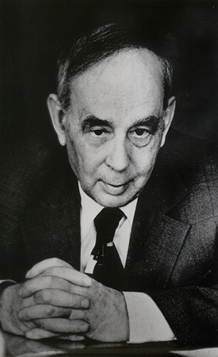
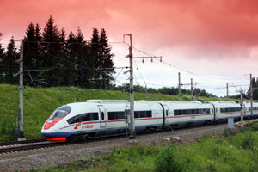
Real-time исследования материалов и процессов на импульсных источниках нейтронов
Анатолий M. Балагуров bala@nf.jinr.ru http://flnp.jinr.ru/
Лаборатория нейтронной физики имени И.М.Франка, ОИЯИ, Дубна
Илья M. Франк
1908 - 1990
Diffraction: TOF vs. λ = Const
Processes: reversible vs. irreversible
RT diffraction at the IBR-2: examples
Single pulse mode
Complimentary techniques
Дубна – Тверь: 100 км – 1.5 ч (авто)
Тверь – С.-Петербург: 600 км – 4 ч (Сапсан)
С.-Петербург – Гатчина: 50 км – 0.6 ч (авто)
------------------------- 750 км – 6.1 часа

Slide 2

3
1
2013 – Peterhof, Russia
2
2014 – Stockholm area, Sweden
4
2016 – Repino, Russia

Slide 3
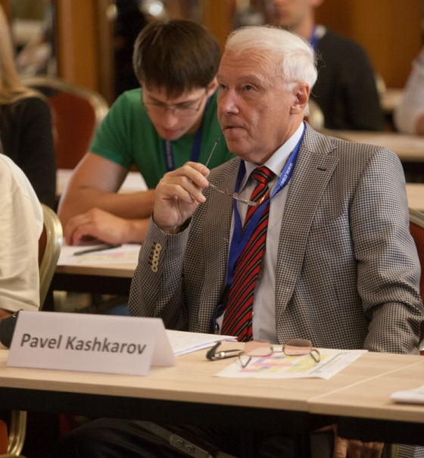
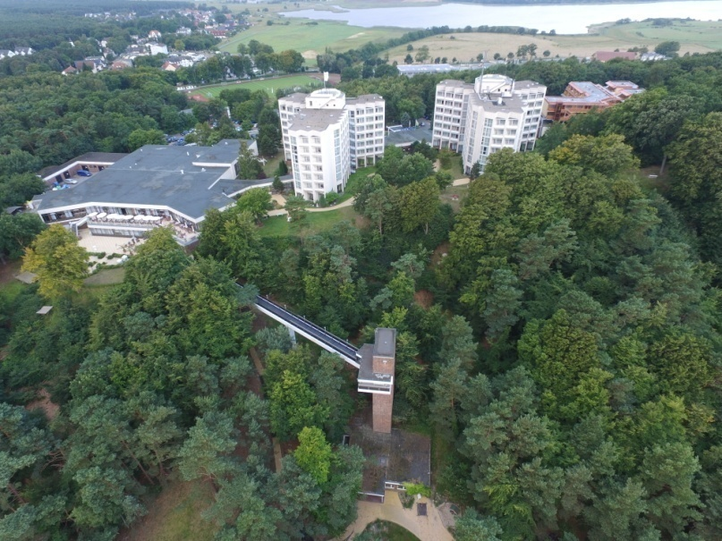
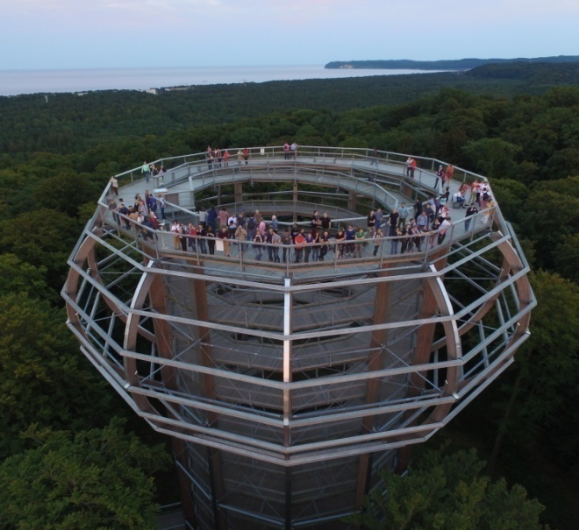
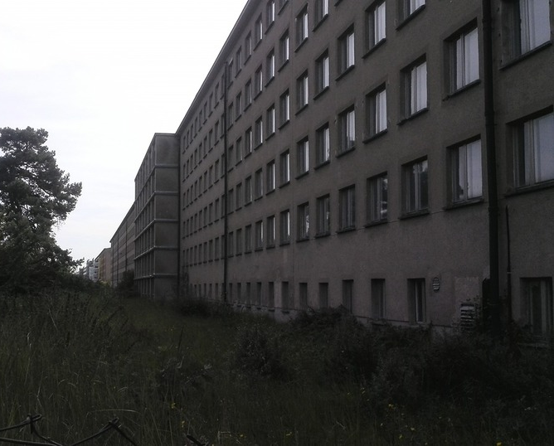
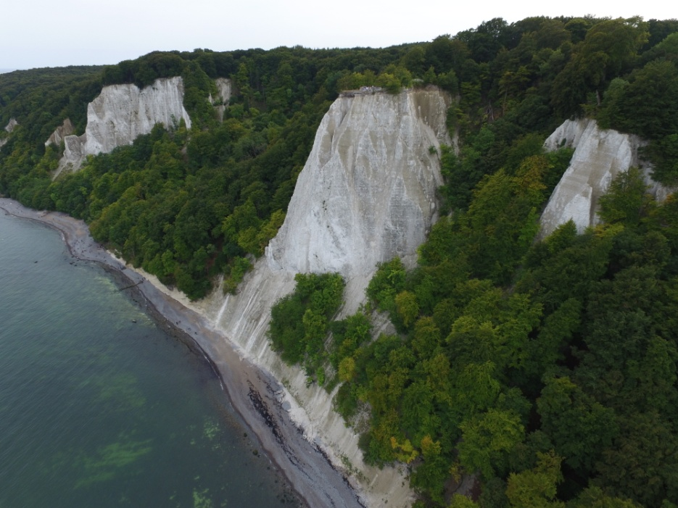
RACIRI Summer School: Island of Rūgen, Germany, August-16

Slide 4
Research neutron sources for condensed matter studies
I. Continuous neutron sources
II. Pulsed neutron sources
W = 10 – 100 MW
Const in time
VVR-M, Russia
IR-8, Russia,
ILL, France
LLB, France
BENSC, Germany
FRM II, Germany
BNC, Hungary
NIST, USA
ORNL, USA
SINQ, Switzerland
--------------
PIK, Russia
II-a. SPS
II-b. LPS
W = 0.01 – 1 MW
Pulsed in time
Δt₀ ≈ (15 – 100) μs
W = 2 – 5 MW
Pulsed in time
Δt₀ ≈ (300 – 3000) μs
ISIS, UK
LNSC, USA
SNS, USA
J-SNS, Japan
IBR-2, Russia
----------------
ESS, Europe
LNSC (new)
???

Slide 5
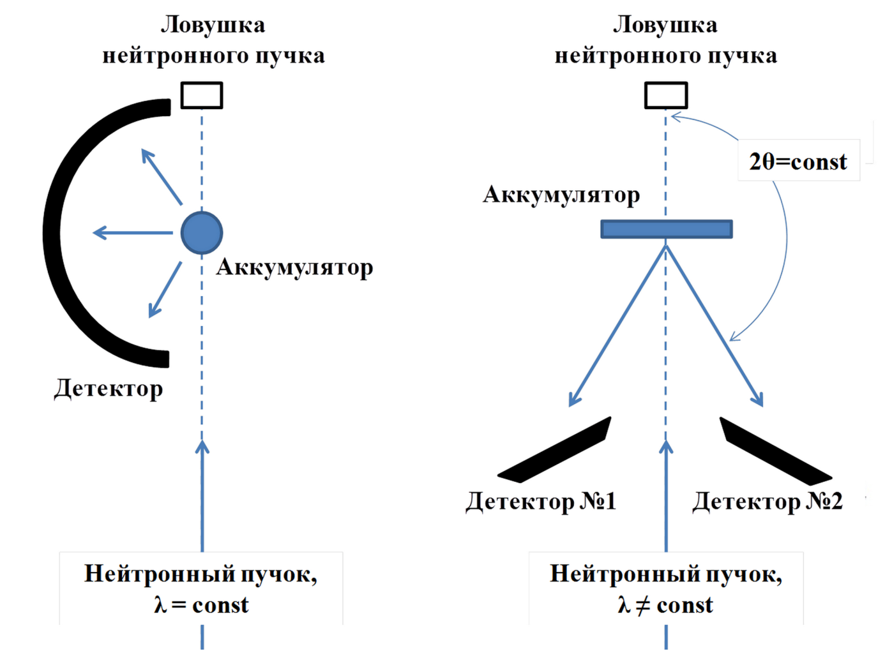
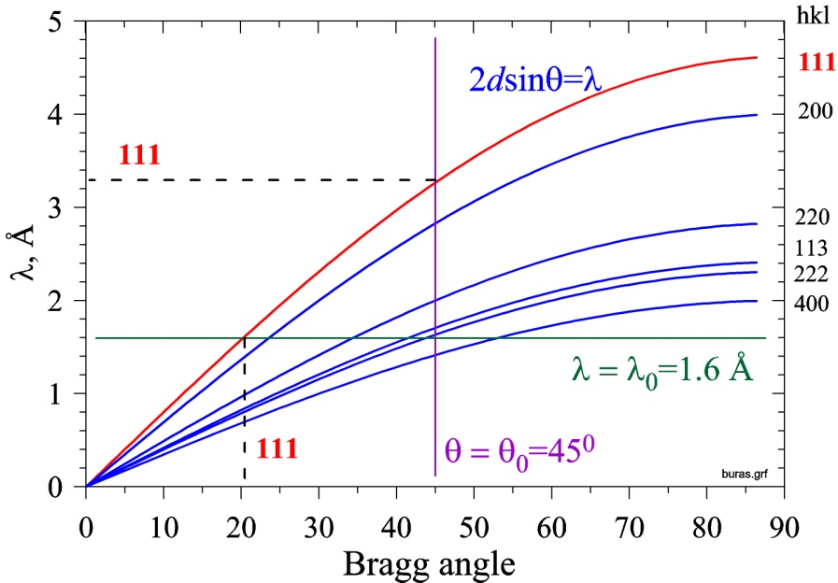
Geometry of neutron diffraction experiment at steady-state
and pulse neutron sources
Beam trap
Beam trap
B. Buras diagram
Sample
Sample
Detector
All diffraction lines can be measured either with fixed λ₀ at different angles or at fixed θ₀ for different wavelengths.
Detector-1
Detector-2
Neutron beam
λ = Const
Neutron beam
λ ≠ Const
Steady state neutron source.
Scattering over 2θ range
Pulsed neutron source.
Scattering at fixed 2θ

Slide 6
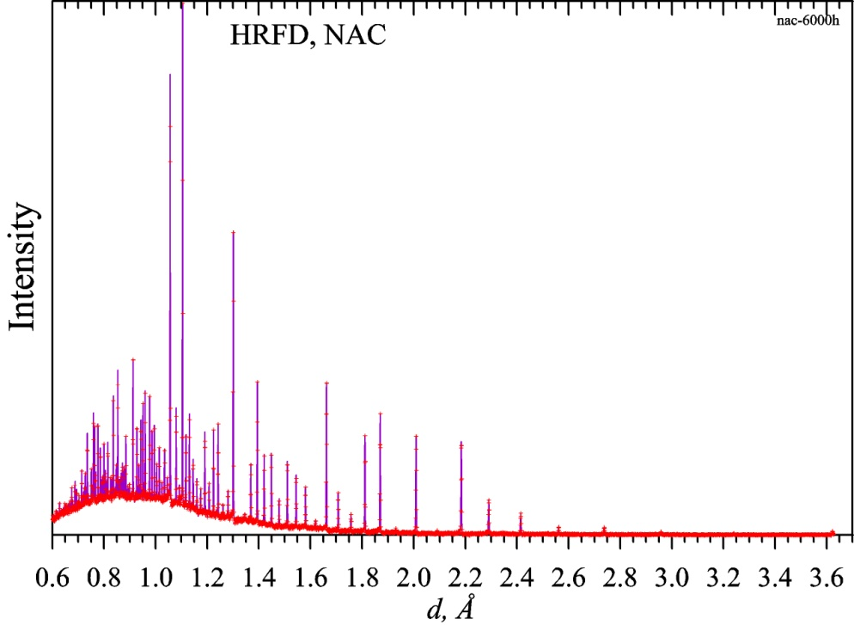
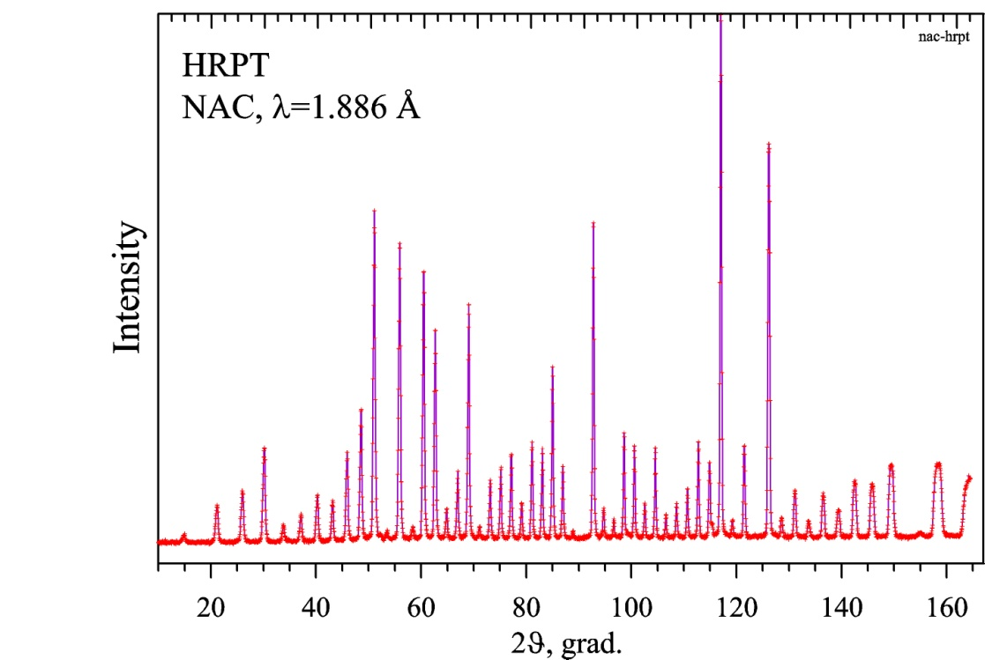
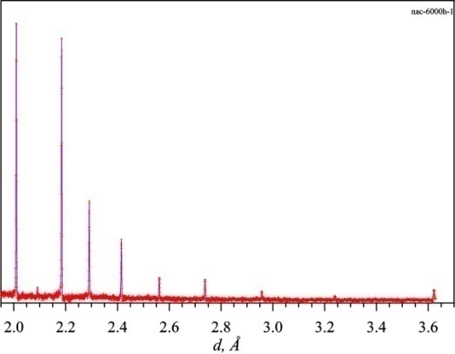
Diffraction patterns (NAC = Na₂Al₂Ca₃F₁₄) measured at
TOF- and λ₀-diffractometers. Raw data
TOF
λ = Const
Diffraction pattern of Na₂Al₂Ca₃F₁₄,
measured with HRFD (IBR-2) at 2θ₀ = 152°
Wavelength range: 1.2 – 7.2 Å
d_{hkl}-range: 0.7 – 3.7 Å
Diffraction pattern of Na₂Al₂Ca₃F₁₄,
measured with HRPT (SINQ) at λ₀ = 1.886 Å
Scattering angle range: 10 – 165°
d_{hkl}-range: 1.0 – 10.8 Å

Slide 7
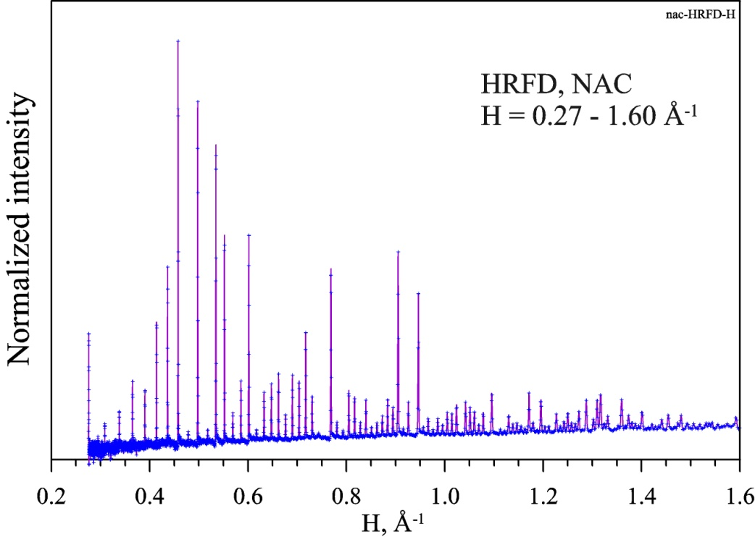
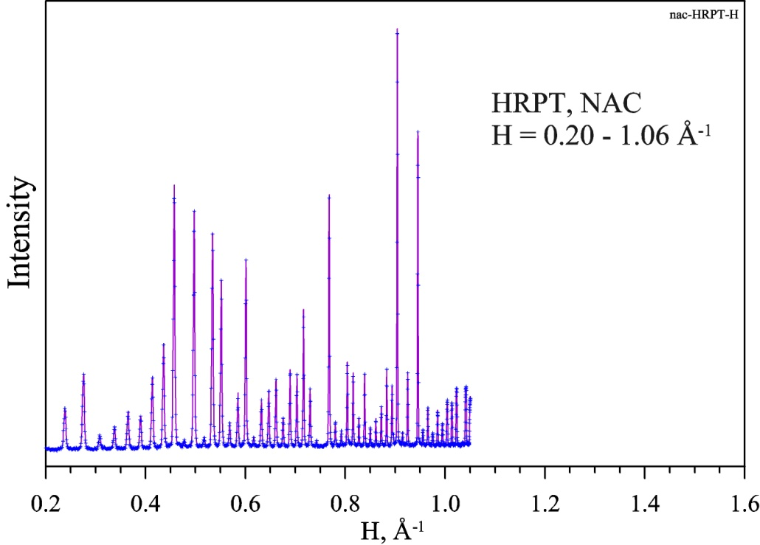
NAC-standard (Na₂Al₂Ca₃F₁₄) at TOF- and λ₀-diffractometers
after transformation into H-scale (H = 1/d)
TOF-diffractometer HRFD: 2θ₀ = 152°,
wavelength range = 1.2 – 7.2 Å
λ₀-diffractometer HRPT: λ₀ = 1.886 Å,
scattering angles range = 10 - 165°
λ₀- and TOF-diffractometers are complementary to each other!

Slide 8
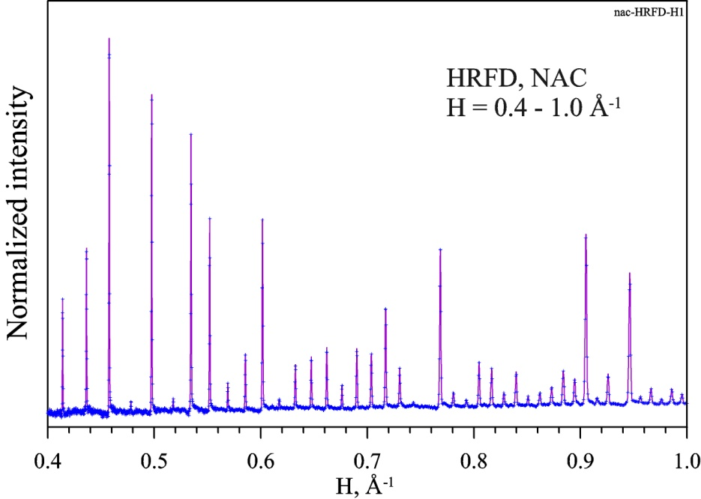
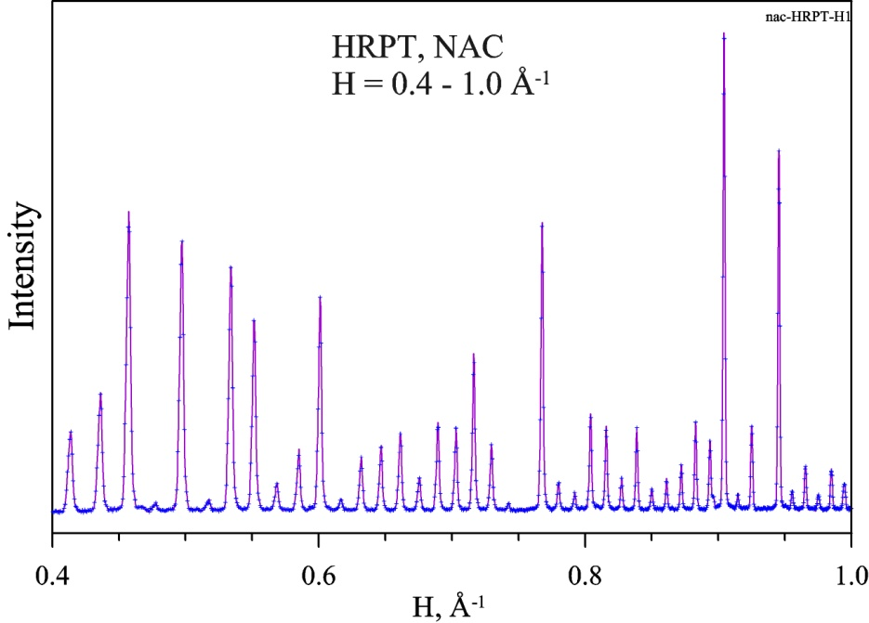
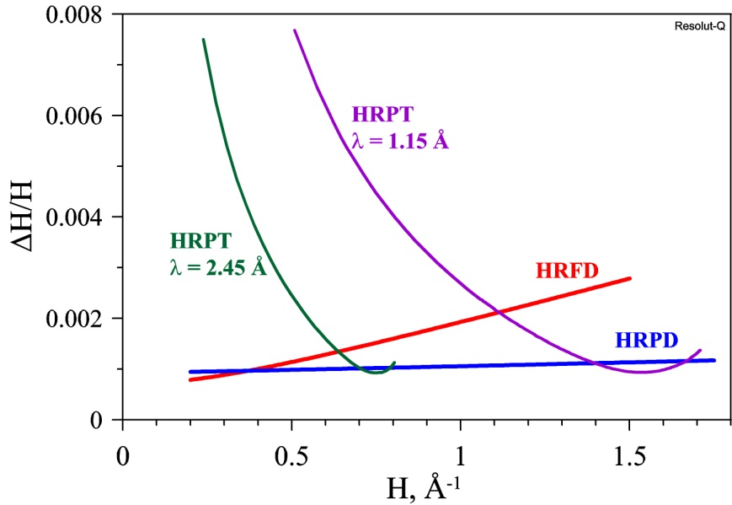
NAC-standard (Na₂Al₂Ca₃F₁₄) at TOF- and λ₀-diffractometers
after transformation into H-scale (H = 1/d)

Slide 9
Transitional phenomena terminology
In situ = in place, in the natural position
In real time = depicting event at the same rate as a process unfold
In operando = a device (battery) is studied during its operation
Reversible process can be started as many times as needed. “Fast” process in microsecond range. Can be reproduced precisely.
Irreversible process can be started only once. “Slow” process in second or minute range. Cannot be reproduced precisely or at all.
Parametric experiment = a sample is under influence of continuous changes of any external parameter (temperature, pressure, …)
Shock experiment = step-like influence of any external parameter (temperature, electric or magnetic field, …) (one-shot experiment)
Thermodiffractometry = temperature dependent neutron or x-ray diffraction

Slide 10
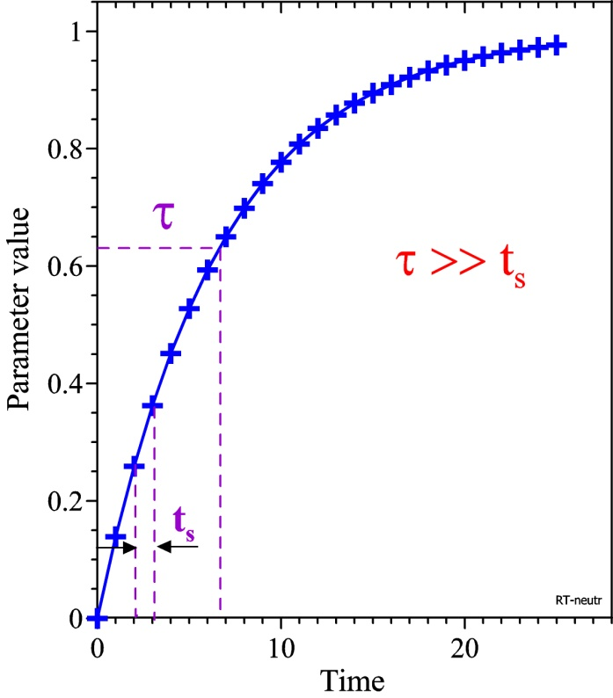
The simplest case of an irreversible process:
A(t) = A∞[1 - exp(-t/τ)] (exponential law)
characteristic time(s) of a process
>>
snapshot time (τ >> t_{s})
Internal parameter
Solid state chemical reactions
Electrochemical processes
Isotope exchange
Phase transformations
Swelling
…
Time / External parameter
Temporal resolution
Δt = t_{s}
t_{s} ≈ 1 s – 10 min, i.e.
τ ~ 10 s – hours

Slide 11
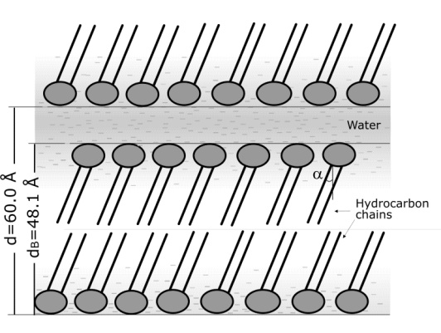
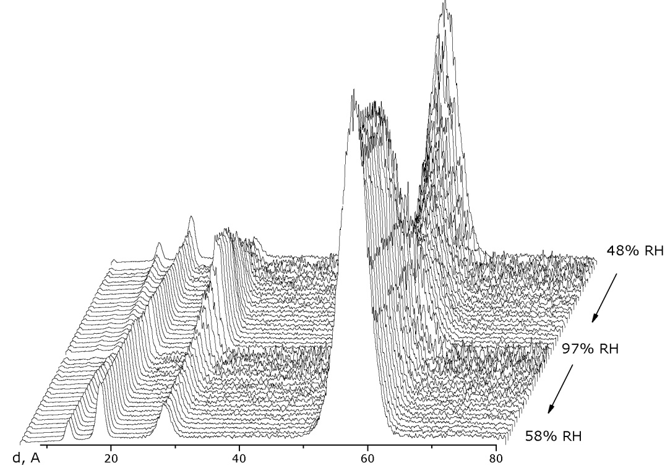
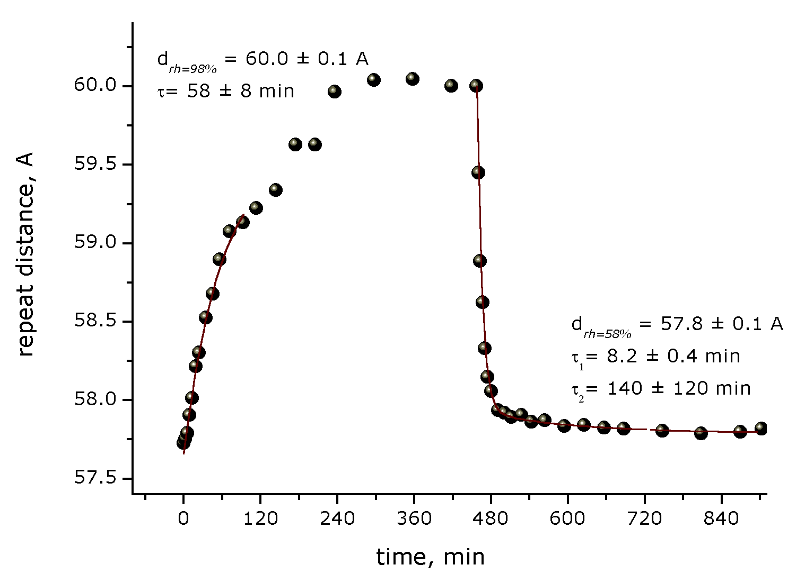
Diffraction on lipid multilayer under humidity changes:
hydration – dehydration process
1
Water between layers
2θ = 11^{о}
Lipid
bilayer
3
2
4
5
Neutron diffraction patterns from DPPC multilayer structure, measured at IBR-2 in real-time mode with t_{s} = 3 min
Changes of the period of the DPPC lipid multilayers: τ₁ = 58 m, τ₂ = 8 m, τ₃ = 140 m
N.Y. Ryabova et al. (2010)

Slide 12
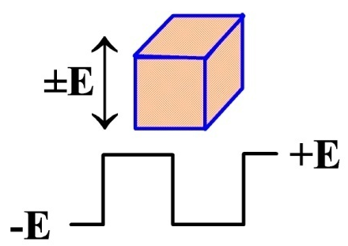
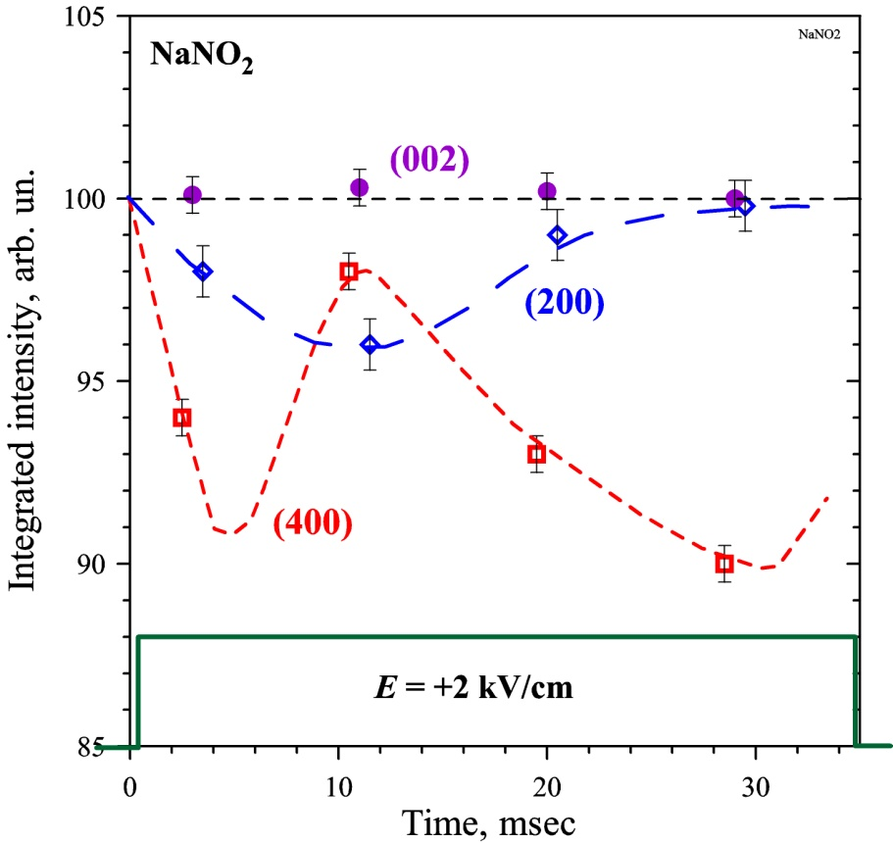
Reversible process: NaNO₂ in electric field (t_{s} = 10 ms)
NaNO₂ single crystal
Experiment: neutron diffraction on NaNO₂ single crystal under electric field pulses with E = 2 kV/cm, Δt ≈ 40 ms
Electric field pulses
Na
N
(010)
O
O
(001)
NO₂
The mechanism of polarization
reversal is a rotation of the NO₂
groups around the [001] axes.
N.Niimura & M.Muto Nucl. Instr. Meth. (1975)

Slide 13
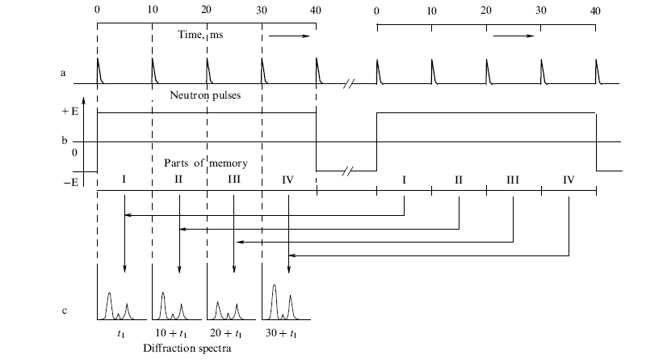
Slow reversible process in external field
source pulses
with period T
external field pulses
T << τ
diffraction patterns
Time diagram of:
a) neutron pulses,
b) external field pulses,
c) diffraction patterns.
Temporal resolution
t_{s} = T

Slide 14
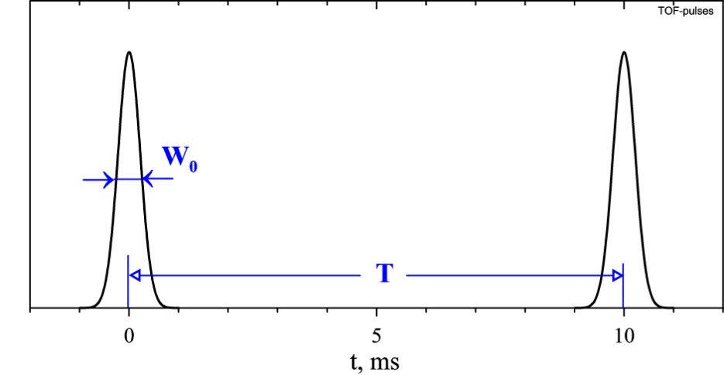
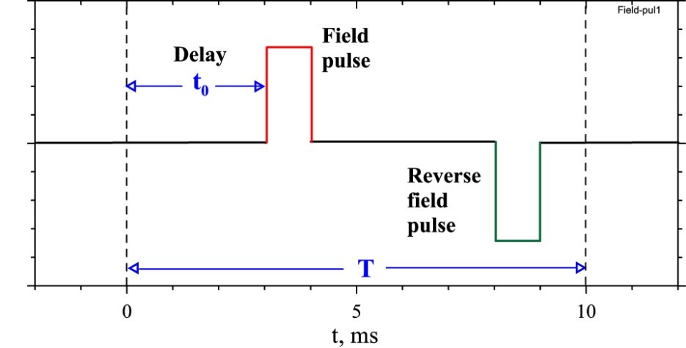
Fast reversible process in external field
W₀ < τ < T
τ – characteristic time of a process
T – source repetition period
W₀ – diffraction peak width
t₀ – field pulse delay
Intensity changes as a function of the delay t₀
Temporal resolution
t_{s} ≈ W₀

Slide 15
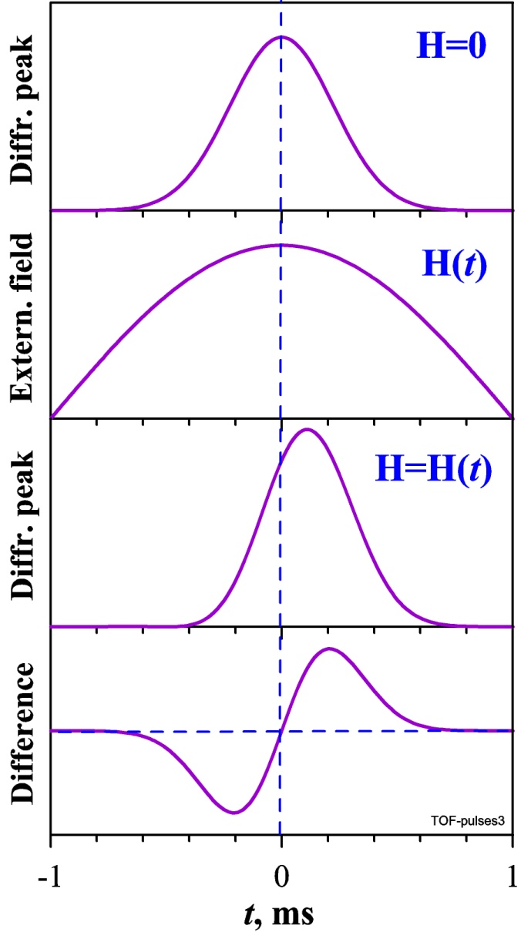
Very fast reversible process in external field
W₀ < τ < T
τ – characteristic time of a process
T – source repetition period
W₀ – diffraction peak width
t₀ – field pulse delay
Peak shape changes as a function of H(t)= H₀sin(π·Δt/T_{H})

Slide 16
Very fast reversible process in external field
TOF analysis at the crystal – detector flight path, L₂
Temporal resolution
Δt/t₂ = [(ΔL₂/L₂)² + (Δθ/tgθ)²]^{1/2}
Source
γ
Δθ² = γ² + η², t₂ = 253·L₂·λ
L₁
Δt/t₂ ≈ 0.01, Δt ≈ 2 – 10 μs
For any type of neutron source!
Detector
Single
crystal
(η)
L₂
H = H₀sin(π·Δt/T_{H})
Field resolution
ΔH/H₀ ≤ π·Δt/T_{H}
ΔH/H₀ ≈ 0.02
for T_{H} = 300 μs

Slide 17
Transitional phenomena & TOF diffraction
Irreversible processes:
Reversible processes:
1 s – 10 min for conventional mode
Slow τ ~ 10 – 1000 ms
Fast τ ~ 100 – 1000 μs
Very fast τ ~ 10 μs
~ 300 μs for one pulse mode
Solid state chemical reaction
Isotope exchange
Second order phase transitions
Polarization or spin reversal
First order phase transitions
New equilibrium state induced by
an external field

Slide 18
Irreversible process:
Intensity (counting rate) of TOF diffractometer
I ≈ Φ₀ · S · (Ω/4π) · δ [n/s]
Φ₀ – integrated neutron flux at a sample ~ 10⁷ n/cm²/s
S – effective sample cross-section 5 cm²
Ω – solid angle of detector system ~ 2 sr
δ – probability of scattering ~ 0.1
“Point” counter: Ω ≈ 0.001 sr
RTD, IBR-2: Ω ≈ 1 sr
GEM, ISIS: Ω ≈ 4 sr
I ≈ 1·10⁶ n/s
d-spacing range (measured simultaneously) is (0.5 – 60) Å for diffraction.
Small angle scattering can be included easily!

Slide 19
High-intensity diffraction at advanced neutron sources
Continuous sources:
ILL (Grenoble) D20 t_{s} ~ 0.3 sec – 5 min
PSI (Switzerland) HRPT t_{s} ~ 2 – 5 min
FRM-II (Germany) SPODI t_{s} ~ 2 – 5 min
Pulsed neutron sources:
ISIS (UK), Polaris t_{s} ~ 5 min GEM t_{s} ~ 1 - 5 min
SNS (USA), VULCAN t_{s} ~ 0.5 – 5 min
LANSCE (USA), HIPD t_{s} ~ 1 - 5 min
J-PARC (Japan), HITD t_{s} ~ 1 – 5 min
IBR-2 (Russia), RTD t_{s} ~ 1 sec – 5 min (~0.3 msec in future)
ESS (Sweden), SPD t_{s} ~ 0.3 msec – 0.5 sec – 5 min

Slide 20
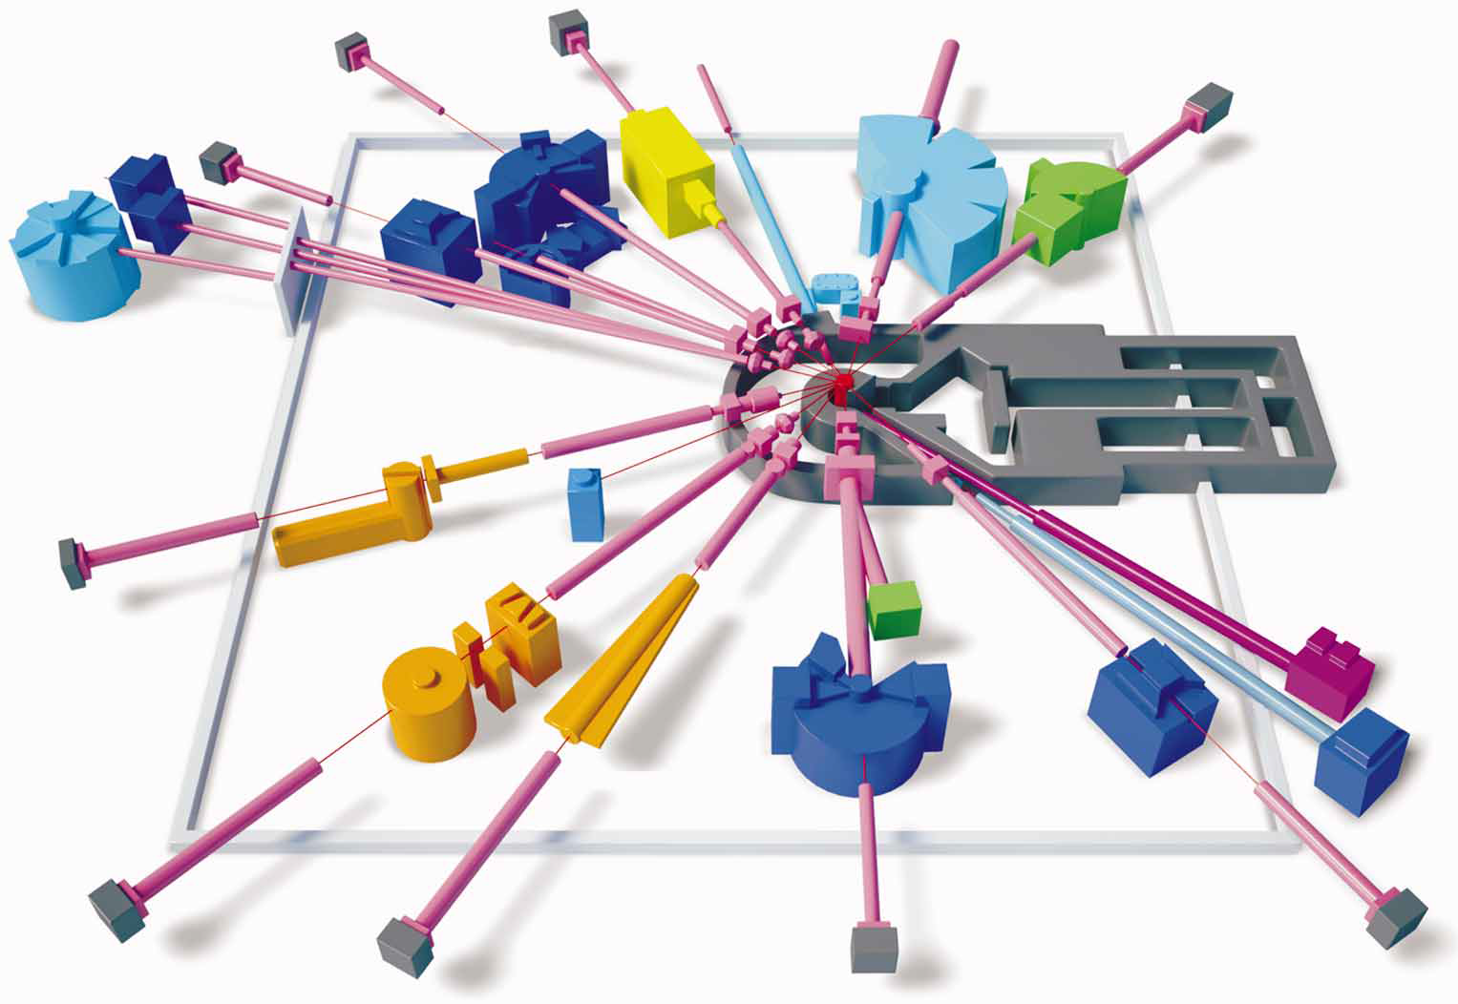
Spectrometers at the IBR-2 reactor
YuMO
EPSILON
HRFD
DIN-2PI
SKAT
DN-6
KOLHIDA
Diffraction: 8
SANS: 1
Reflectometry: 3
Inelastic: 2
Imaging: 1
NERA
RTD
REMUR
REGATA
IZOMER
NRT
REFLEX-P
GRAINS
FSD
DN-12
FSS

Slide 21
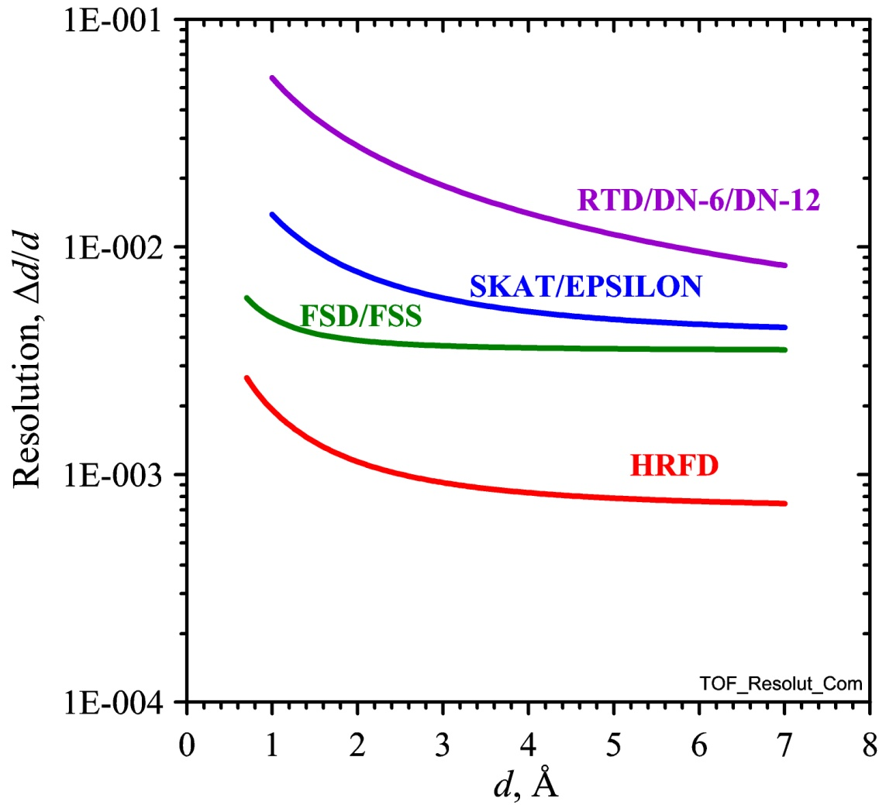
Diffraction at the IBR-2: Resolution
HRFD powders
FSD stresses
RTD real-time, multilayers
DN-6 high-pressure
Epsilon stresses
SKAT textures
DN-12 high-pressure
FSS stresses
Resolution becomes better for longer d-spacing!
21

Slide 22
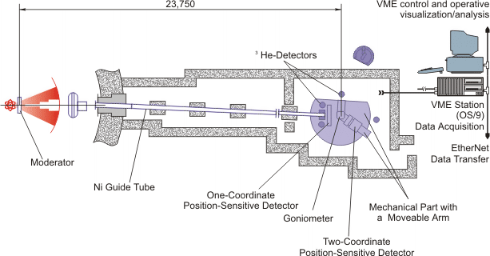
Irreversible processes at the IBR-2: TOF diffractometer “DN-2”
D4 170° 1 – 4 Å
D3 150° 1 – 6 Å
D2 10-30° 5 – 65 Å
D1 ~1° SANS
Constructed in 1984
Φ₀ ≈ 1.3·10⁷ n/cm²/s
L₁ = 24.2 m, L₂ = 0.5 – 2.0 m
Ω ≈ 0.03 sr, Δd/d ≈ 0.01 – 0.1
λ_{min} ≈ 0.8 Å, λ_{max} ≈ 20 Å
D3
D1
D4
D2
n
Sample inside a furnace
with wide windows

Slide 23
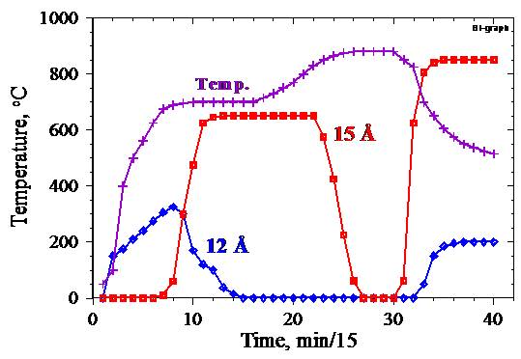
Phase transformations in BiSrCaCuO_{x} (melt-quenching, heating, melting, cooling down).
First combined diffraction – SANS study (1988) with t_{s}=5 min
Diffraction intensity. d_{hkl} range is 10 – 18 Å. (002) peaks for (2201) and (2212) phases are seen.
(2212) = Bi₂Sr₂CaCu₂O_{x}, T_{c} ~ 110 K
(2201), T_{c} ~ 10 K
15 Å
12 Å
Time scale
TOF scale
Time scale
Melted state
TOF scale
SANS intensity.
Q range is 0.02 – 0.06 Å⁻¹
Temperature & Intensities changes
A.M.Balagurov, G.M.Mironova, MS Forum, 1993

Slide 24
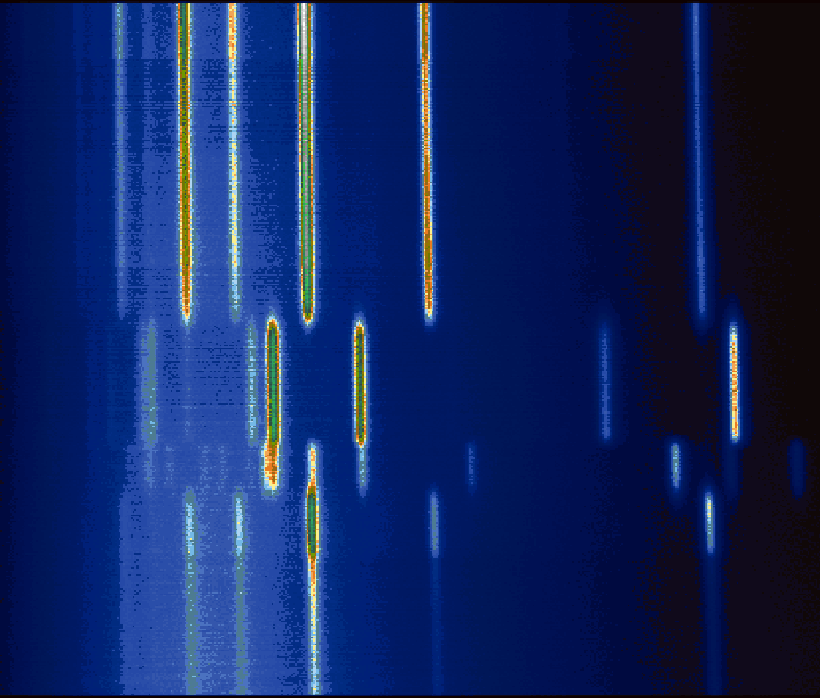
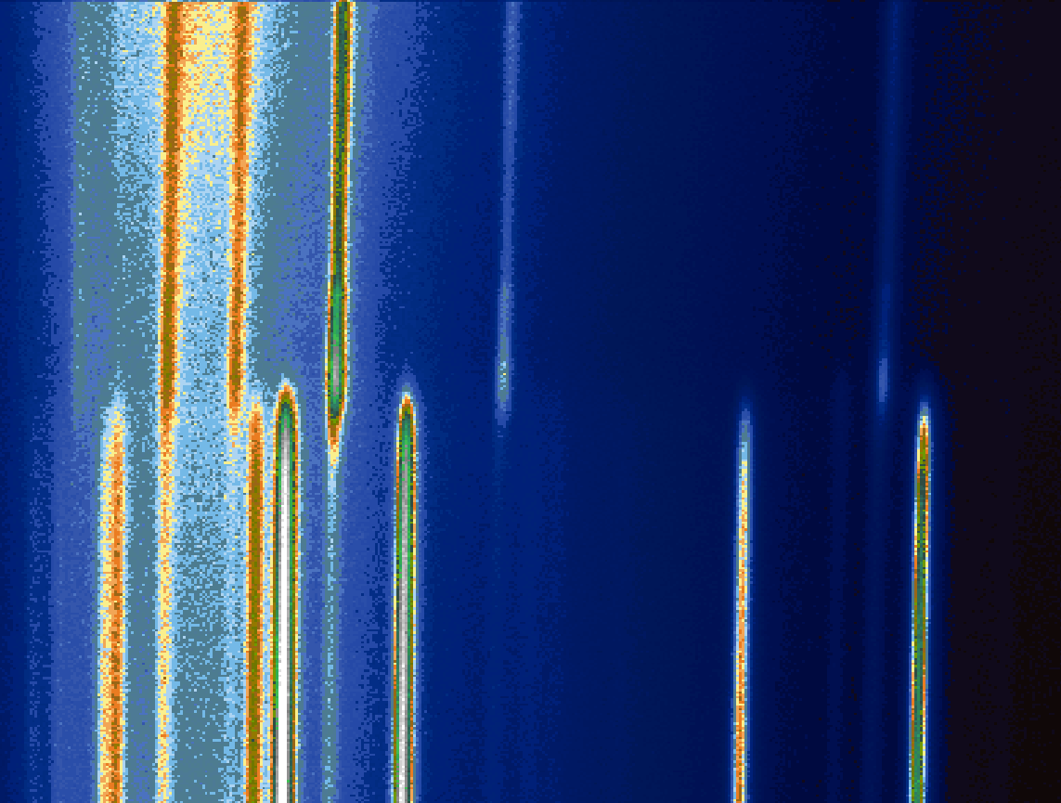
Структурные фазовые переходы в сплавах Fe-Ga при
нагревании – охлаждении в интервале 20 - 900°С
(дифракция нейтронов, реактор ИБР-2, дифрактометр HRFD, t_{s} = 1 min)
D0₃
A2
L1₂
D0₁₉
L1₂
A2
2D представления фазовых переходов в образце Fe-27Ga при нагревании (слева) и охлаждении (справа). Нагрев – охлаждение велись со скоростью 2.5°С/мин. Дифракционные спектры измерялись каждую минуту.

Slide 25
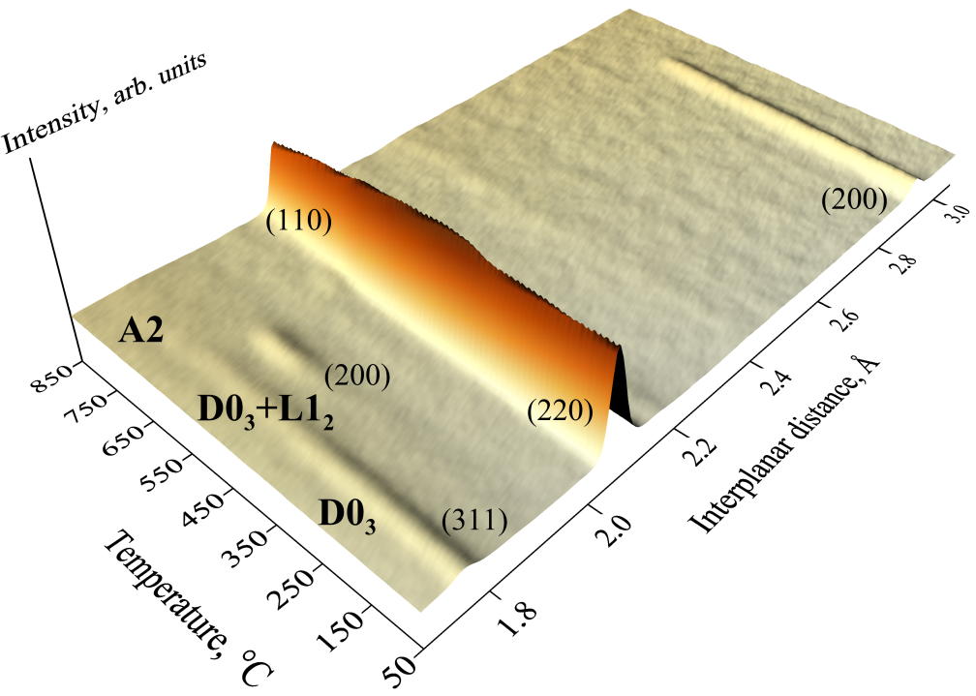
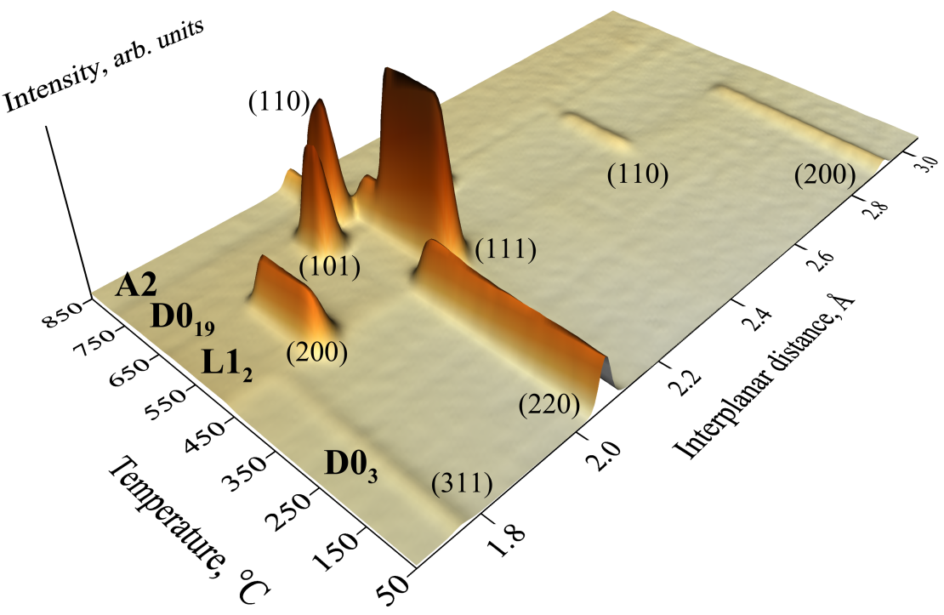
Структурные фазовые переходы в сплавe Fe-Ga при нагревании от комнатной температуры до 850°С, ΔT/Δt = 2 град/мин с t_{s} = 1 мин
Fe-24.8Ga
Fe-27.4Ga
3D представления фазовых переходов в составах Fe-24.8Ga и Fe-27.4Ga в интервале межплоскостных расстояний от 1.75 Å до 3.1 Å и диапазоне температур от 50 до 850°С.

Slide 26
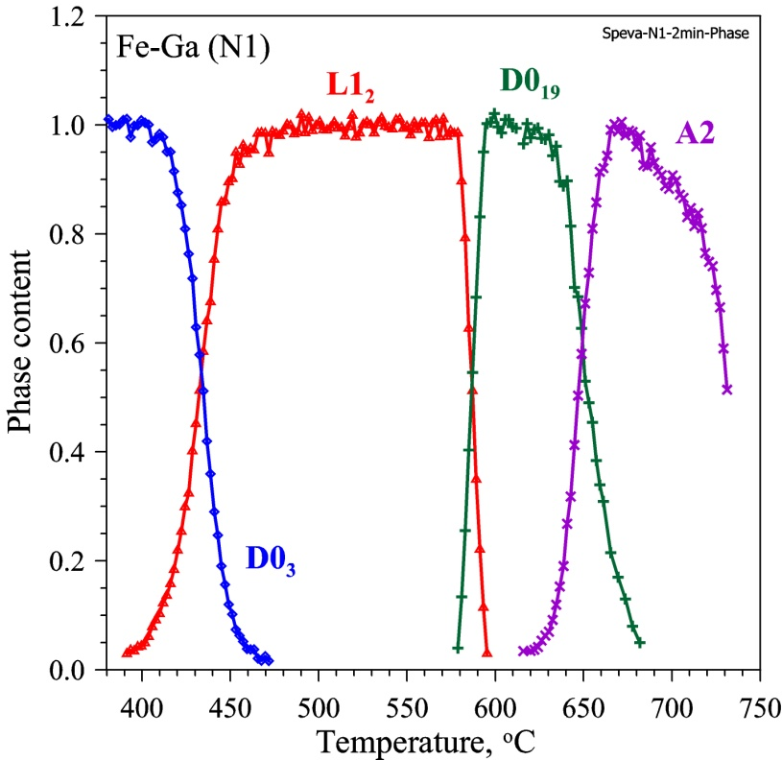
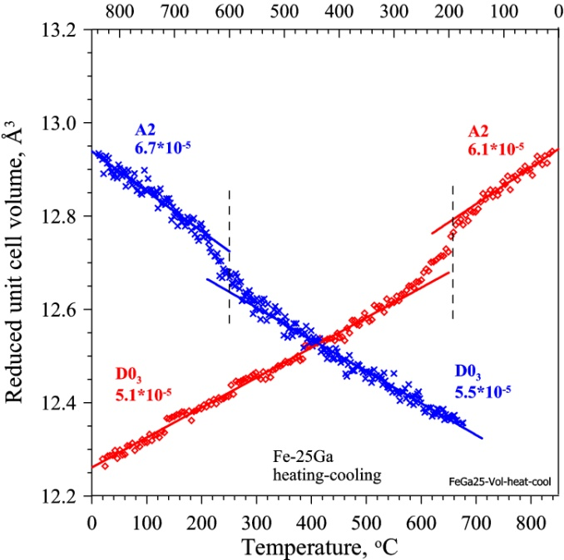
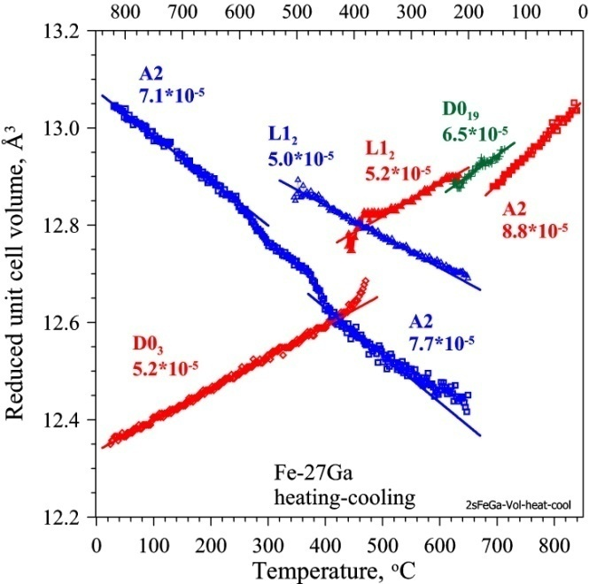
Структурные фазовые переходы в сплавах Fe-Ga
при нагревании-охлаждении с ΔT/Δt = 2 град/мин
Изменения объемов (нормированных) элементарных ячеек образцов Fe-25Ga и Fe-27Ga в ходе нагревания (нижняя шкала, красные точки) и охлаждения (верхняя шкала, синие точки). Для Fe-25Ga показаны объемы ячеек фаз D0₃ и A2, для Fe-27Ga - объемы ячеек фаз D0₃, L1₂ и A2. Фаза D0₁₉, появляющаяся в Fe-27Ga при нагревании, выделена зеленым цветом. Рядом с обозначениями фаз приведены значения объемного КТР (в единицах 1/град), определенные по участкам с линейным изменением объема.
Fe-24.8Ga
Fe-27.4Ga
Изменение содержания фаз в образце Fe-27Ga при нагреве со скоростью 2 град/мин, полученное нормировкой интенсивностей характерных дифракционных пиков на их максимальные значения.

Slide 27
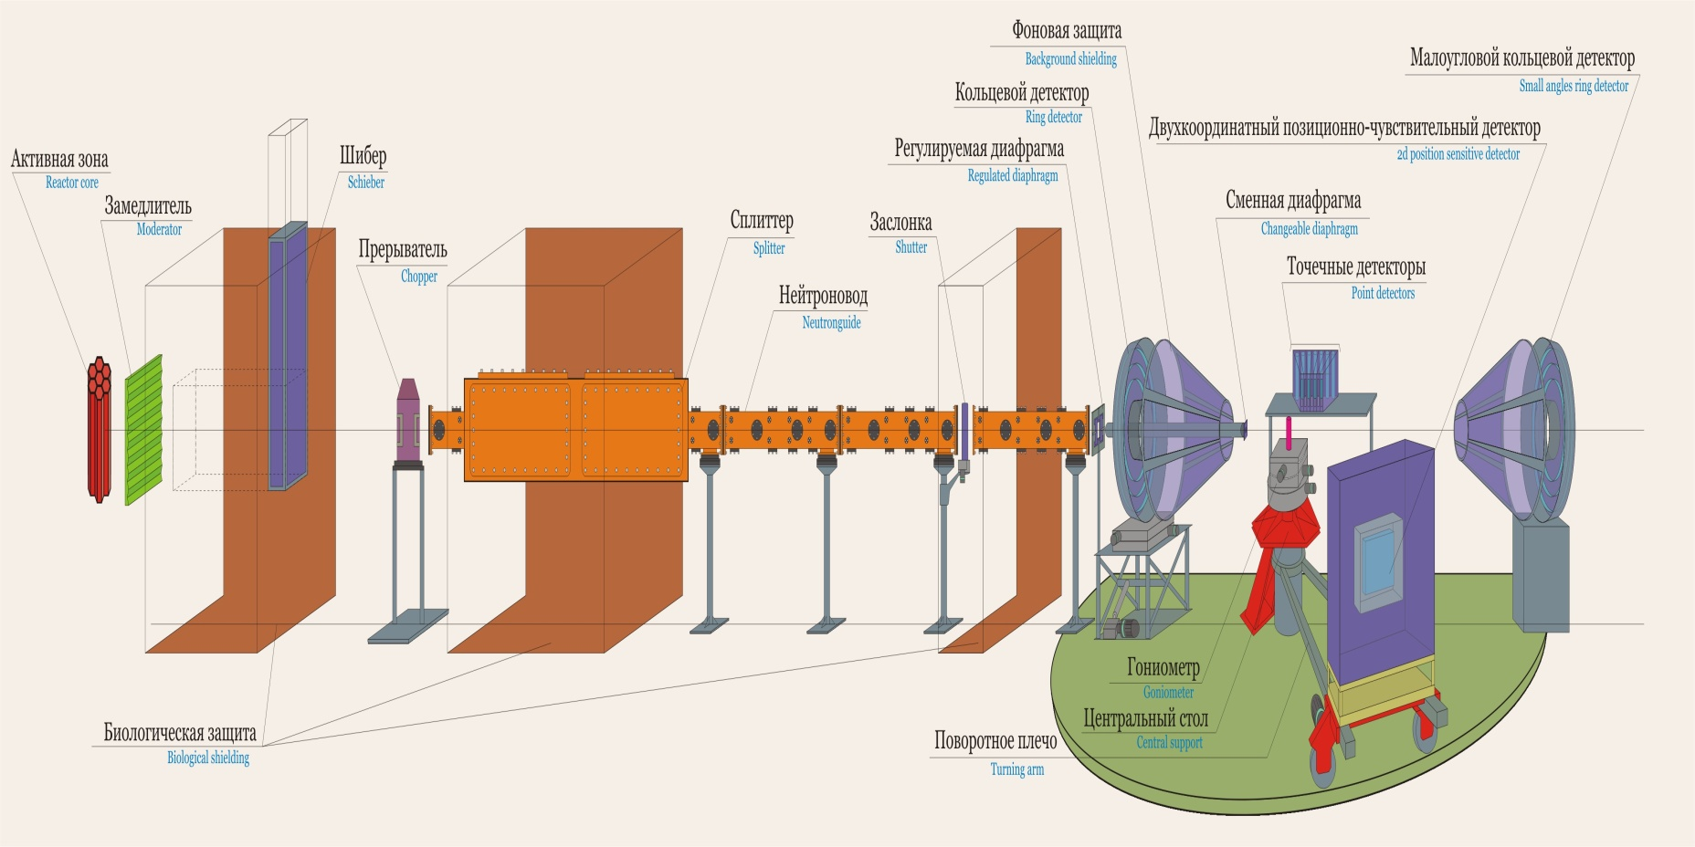
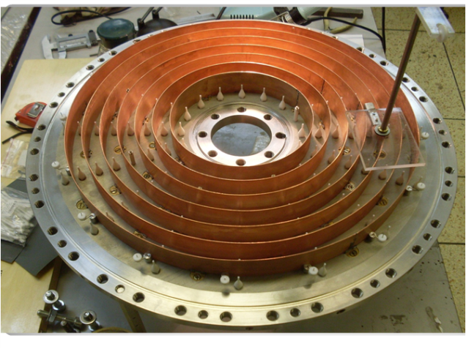
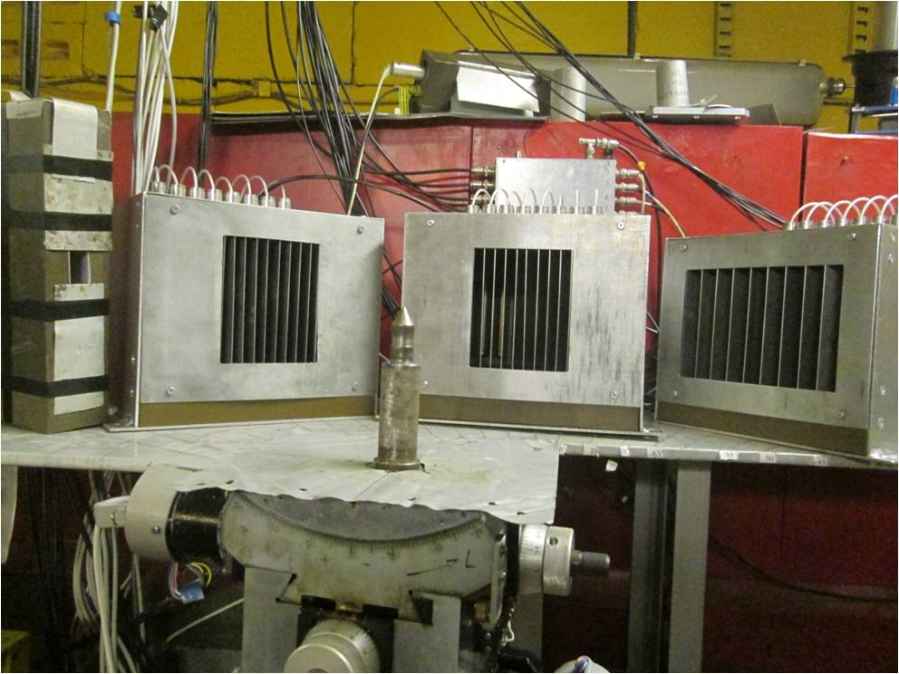
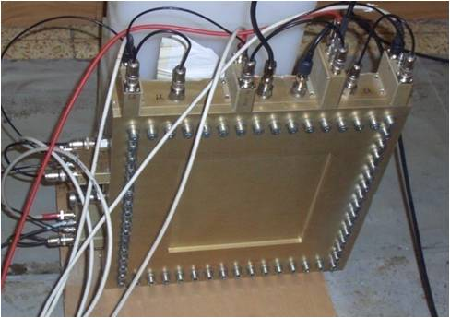
Real-Time-Diffractometer (RTD)
SANS
multi-ring detector
Back-scattering
multi-ring detector
IBR-2:
active core
moderator
Biological
shielding
Shutter
90° multi-element
³He detector
Neutron
guide tube
Background
chopper
6A , 6B beam
splitter
Central table,
sample position
2D PSD
on rotating arm
24 ³He counters, 2θ = 30° - 140°, Δθ = 2°
Ring-shape, back-scattering
D_{min} = 150 mm, D_{max} = 450 mm
2D PSD, 32x32 wires, 2x2 mm

Slide 28
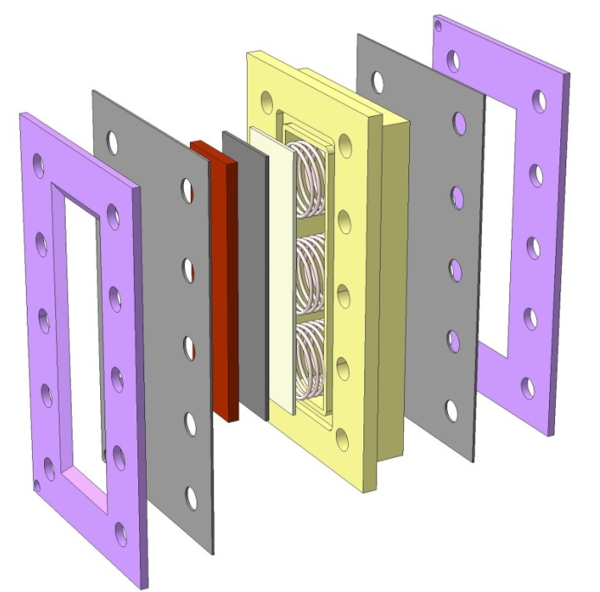
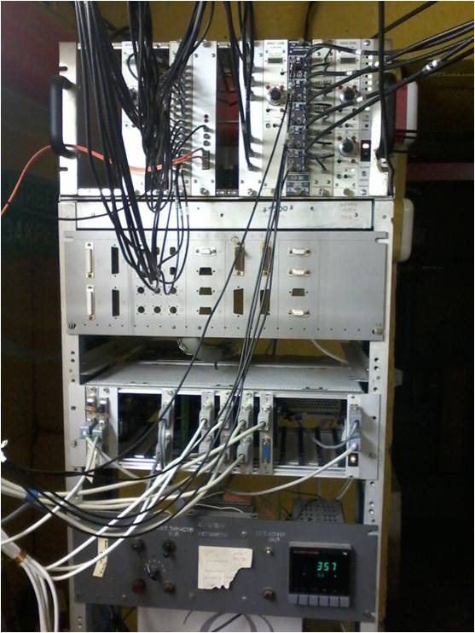
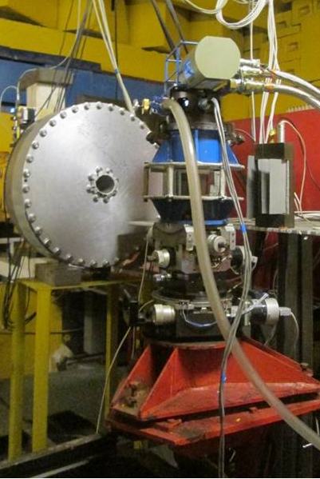
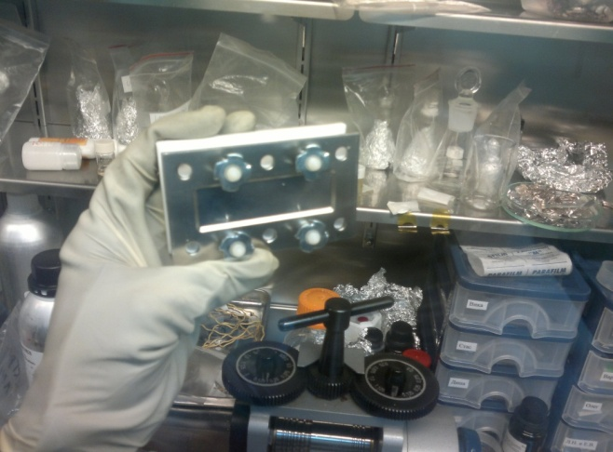
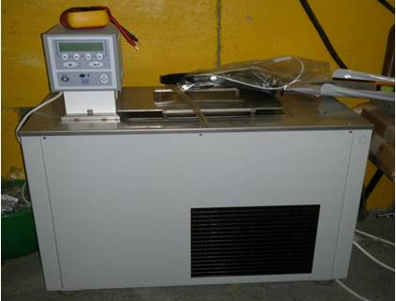
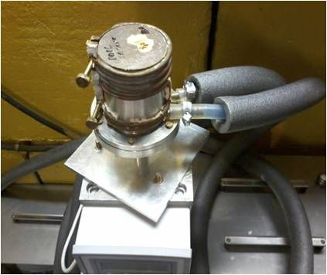
RTD units
Electrochemical cell with vanadium windows
Electronics for data acquisition and remote control
Refrigerator on goniometer with single crystal inside
Thermostat (-40 ≤ T ≤ 100°C) and humidity cell

Slide 29
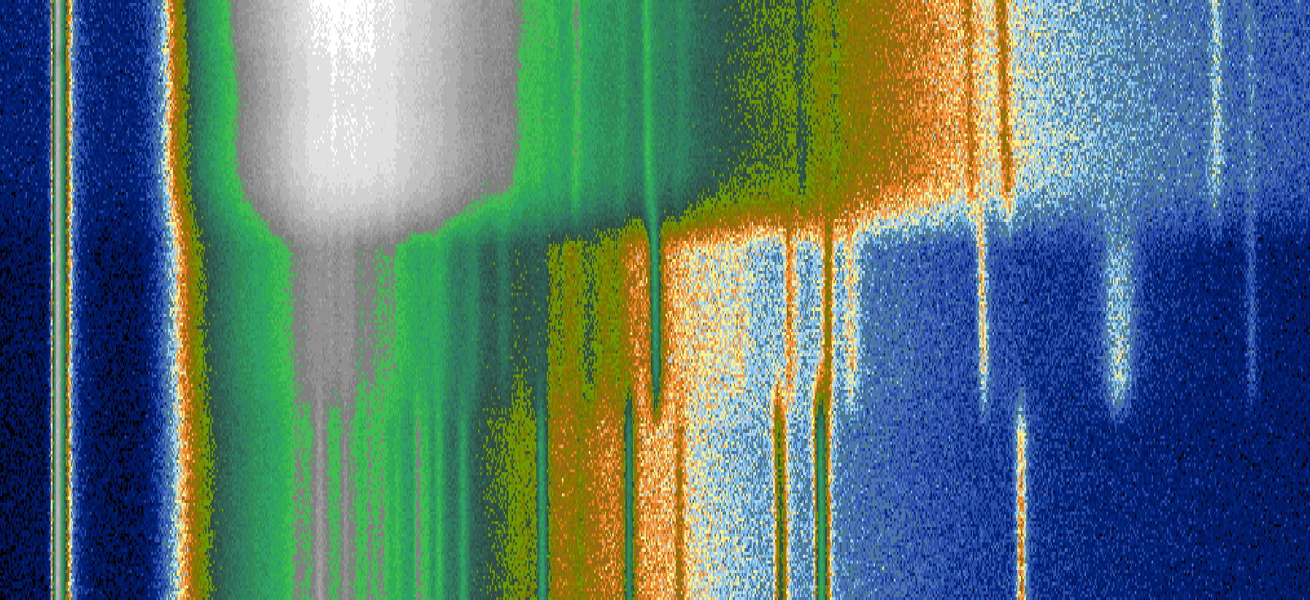
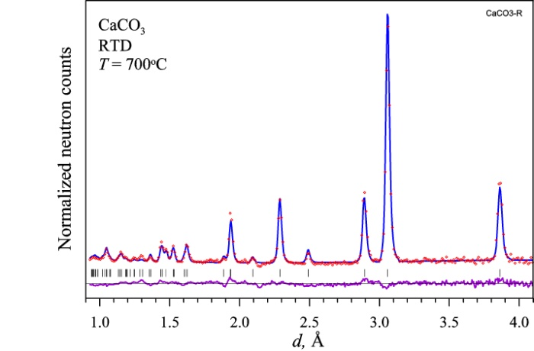
Calcium oxalate monohydrate thermal decomposition, t_{s} = 1 min
0
20°C
CaC₂O₄·H₂O
183°C
t, min
CaC₂O₄
540°C
CaCO₃
200
5.0
700°C
0
d_{hkl}, Å
Ca(COO)₂·H₂O → Ca(COO)₂ + H₂O (T_{c} = 183°C)
Ca(COO)₂ → CaCO₃ + CO (T_{c} = 540°C)
Ca(COO)₂·H₂O: P2₁/c CaCO₃: R-32/m

Slide 30




RTD test: charge-discharge of a real Li-battery, t_{s} = 75 sec
The snapshot time is 150 s, 2.5 < U < 4.34 V, rate = 0.1 C
New ring detector at
the RTD diffractometer
Anode: Li_{x}C₆,
Cathode: Li_{x}Ni_{0.8}Co_{0.1}Al_{0.1}O₂
Total C: 3100 mAh
The snapshot time is 75 s, 2 < U < 4.34 V, rate = 0.2 C. Potentiostatic mode at U = 4.34 V (2 hours)

Slide 31







RTD test: charge-discharge of a real Li-battery, t_{s} = 75 sec
LiC₂₄
LiC₆
LiC₁₂
Enlarged part of “anode” window with diffraction peak from Li_{x}C₆ phases

Slide 32

Single pulse mode at TOF diffractometer with multi-detector
Pulsed
source
Δt = 506·L·d·cosθ·Δθ
Δt ≈ 1 ms
for Δθ ≈ 3°
L₁
Detectors
Sample
2d·sinθ = λ, Δλ = 2d·cosθ·Δθ
Δt = 506·L·d·cosθ·Δθ = 18·Δθ ms
for d = 2 Å and 2θ = 90°
Step-like improvement of temporal resolution of TOF diffractometer if the one-pulse limit is overcome
G.M.Mironova, JINR, Р13-88-326, 1988

Slide 33



Single pulse mode at TOF diffractometer with multi-detector
Blocks of ³He counters with
Δθ = 2°
Fe powder measured in 6 sec (30 pulses) and after 1 pulse (0.2 sec) of the IBR-2
Diffraction peak shift (~500 μs) in neighboring counters

Slide 34
Single Pulse Diffractometer at ESS (proposal)
L = 10 m, 0.5 < λ < 8 Å, Δd = 0.25 - 50 Å, Ω_{d} ≈ 5 sr
Φ₀ = 1∙10⁹ n/cm²/s, Δd/d = 0.5% (2θ = 170°), 0.9% (2θ = 90°), 5% (2θ = 10°)
Applications: ultra-fast processes (Δt ≈ 300 μs),
ultra-small samples (V_{s} ≈ 0.001 mm³)

Slide 35


Neutron imaging for in situ metrology of Li in LFP Batteries
Jason B. Siegel et al., University of Michigan & NIST, USA
Micro-Channel Plate detector:
- resolution is 22 μm,
pixel size is 5x5 μm,
S = 3x25 mm²
The pouch cell construction and an expanded view of the electrode structure
The total thickness of each unit is:
84 μm (negative electrode) + 126 (positive electrode) + 50 (separator) = 260 μm
Main components of neutron imaging beam line

Slide 36


Neutron imaging for in situ metrology of Li in LFP Batteries
Jason B. Siegel et al., University of Michigan & NIST, USA
Charge and discharge profile applied to the battery during imaging: voltage (upper) and stored energy (lower). Duration of experiment is ~15 h. Images are acquired continuously during the experiment
with a 2 min exposure time for each.
Images from the charge and discharge profile corresponding to 100%, 50%, and 0% SOC.

Slide 37



Zoomed plot of the 3 central layers: swelling and Li migration are seen
100% SOC
50% SOC
Al Cu collectors
0% SOC
LiFePO₄
(cathode)
LiC₆ (anode)
LiC_{n}
(n > 6)
During discharge process Li migrate from anode to cathode. The anode 100% SOC state is LiC₆ (low transmission), while for 0% SOC state transmission is high (LiC_{n}).

Slide 38



You are invited for experiments at the IBR-2 reactor
in Dubna – a nice place at the Volga River
Volga River
Dubna city
(the right Bank)
Dubna city
(the left Bank)
Shipping lock
“Moscow see”,
Hydropower station & Dam
Frank Lab of Neutron Physics
JINR Directorate building

Slide 39





Many thanks to my friends in science! Joint work with them is exciting!
Evgeny Antipov
Moscow State
University
Volodya Pomjakushin
FLNP and PSI
Neutron RT studies were started at FLNP in middle of 1980th by diffraction group.
Left to right: Boris Savenko, Anatoly Beskrovnyj, Maja Dlouha (Czechia), Anatoly Balagurov, Galina Mironova
Ivan Bobrikov
FLNP
Denis Sheptyakov
FLNP and PSI

