Slide 1
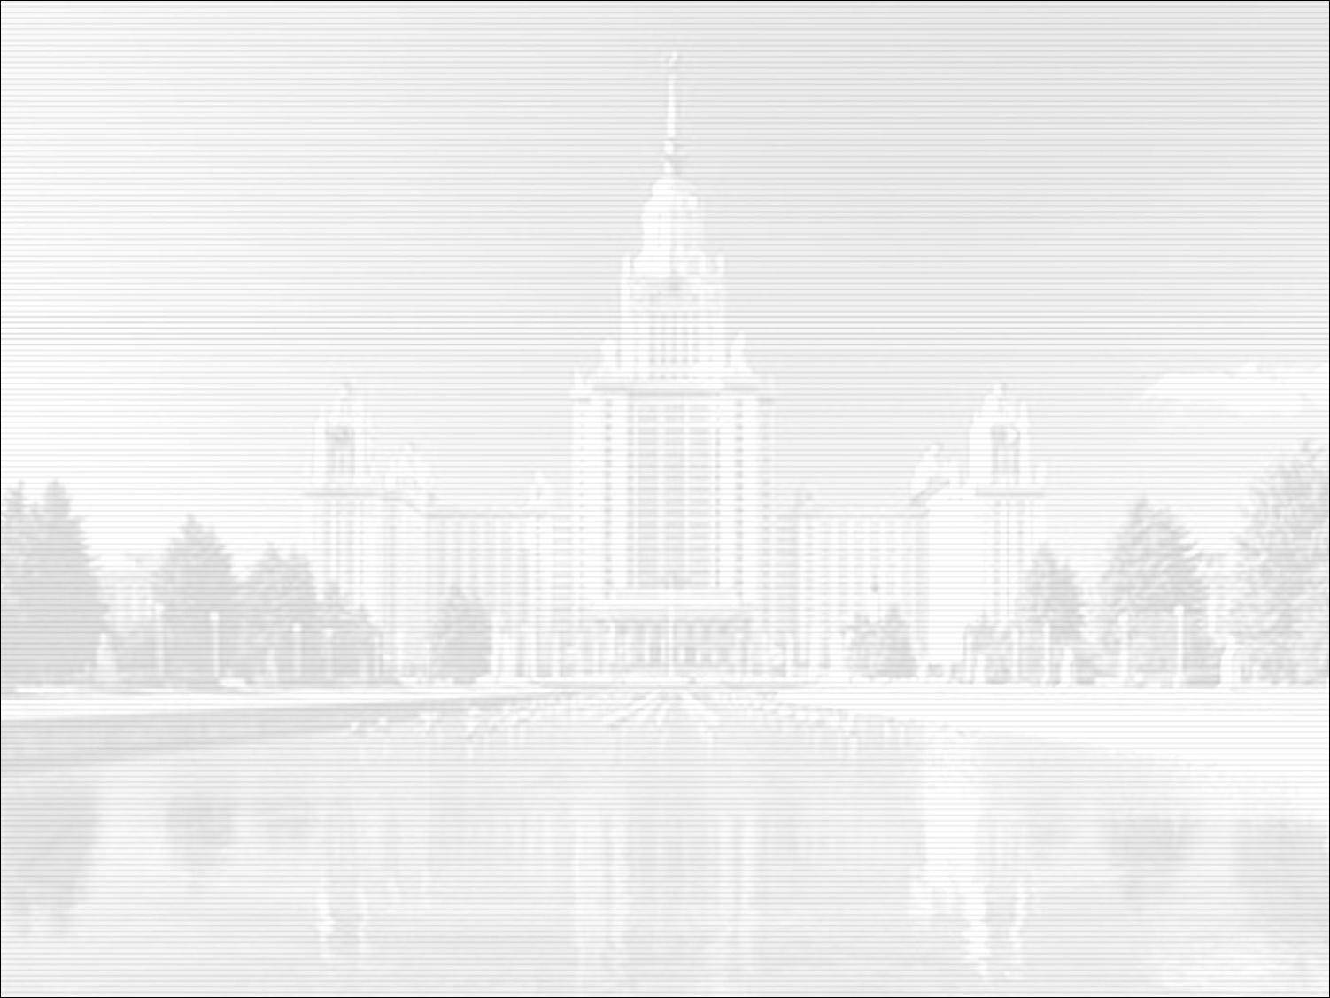
Correlation Fourier diffractometry at long-pulse neutron sources: the 25th anniversary of the technique at the IBR-2 reactor
Anatoly M. Balagurov
Frank Laboratory of Neutron Physics, JINR, Dubna, Russia
Historical moments: Dubna-Gatchina-Espoo
Alternatives of high-resolution neutron diffraction
Fourier technique for neutron diffraction
HRFD at the IBR-2 pulsed reactor
Perspectives of the Fourier technique
1

Slide 2
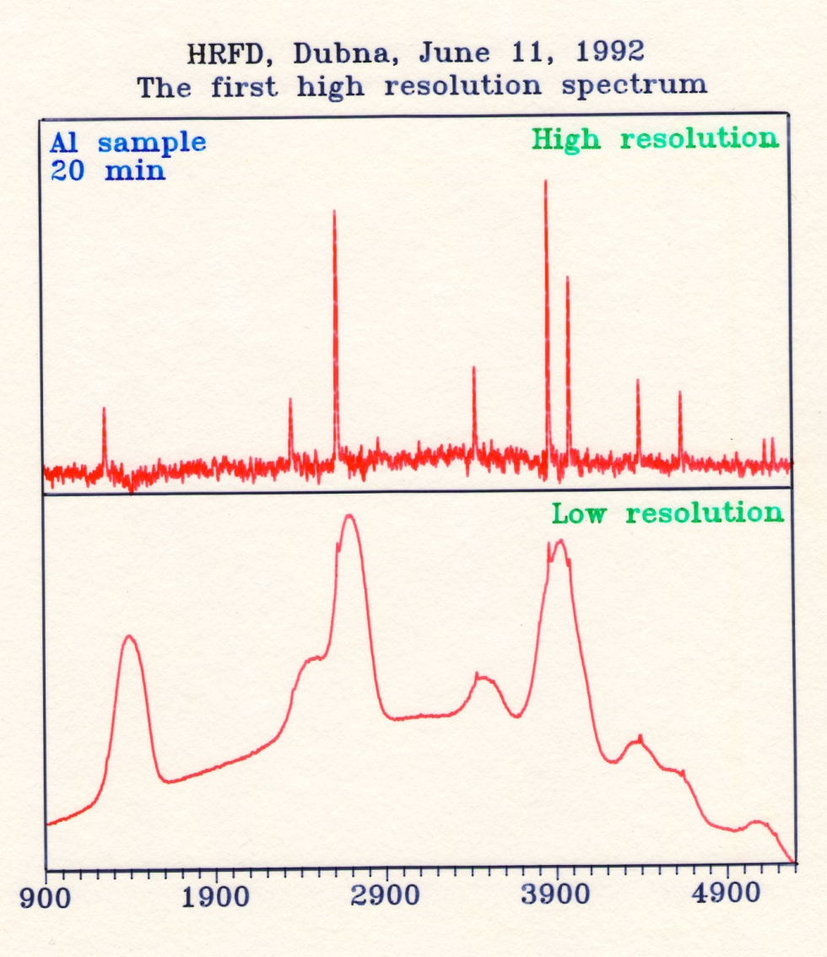
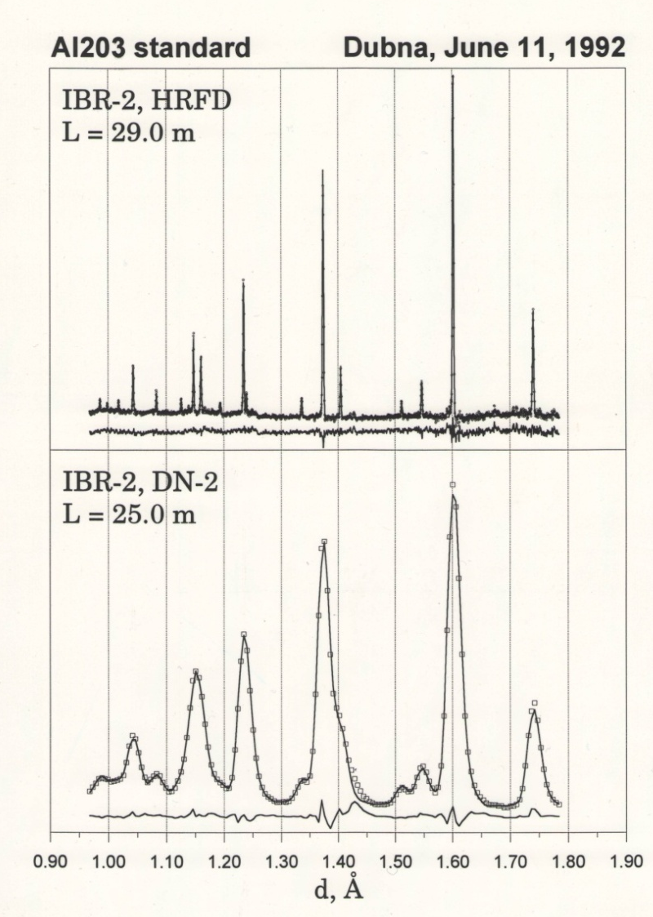
The very first high-resolution diffraction pattern measured
with HRFD, 11.06.1992, Δd/d ≈ 0.0015

Slide 3
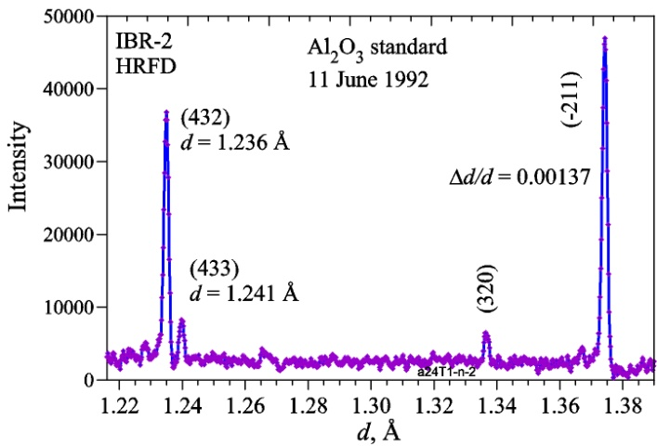
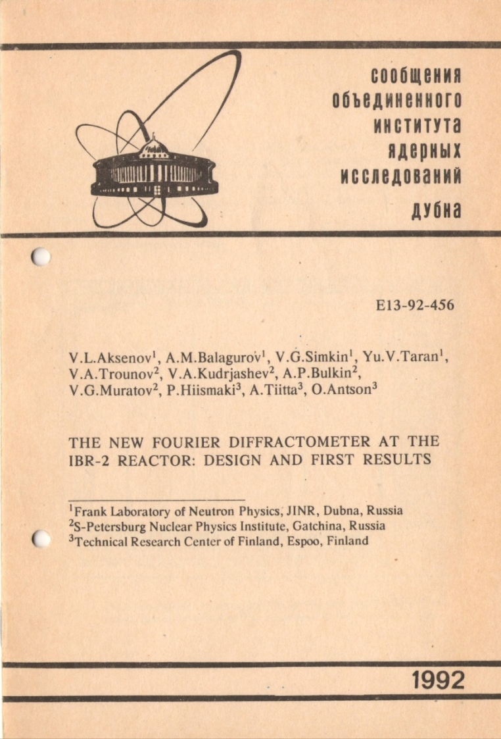
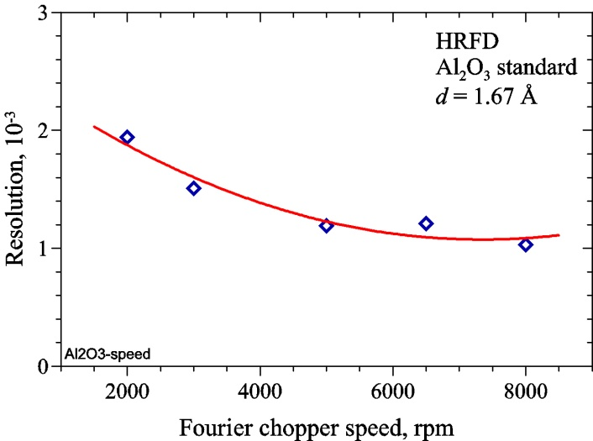
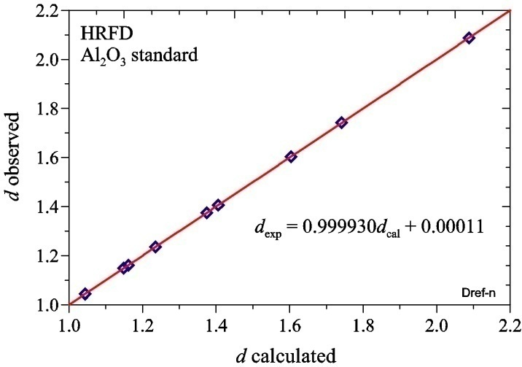
The first description of the HRFD:
design and results
Co-authors from
JINR:
V.L. Aksenov
A.M. Balagurov
V.G. Simkin
Yu.V. Taran
PNPI:
V.A. Trounov
V.A. Kudrjashev
A.P. Bulkin
V.G. Muratov
VTT Espoo:
P. Hiismaki
A. Tiitta
O. Antson
A.M.Balagurov, P.Fischer, T.Yu.Kaganovich, E.Kaldis, J.Karpinski, V.G.Simkin, V.A.Trounov “Precision Fourier neutron diffraction study of the high-temperature superconductor Y(⁴⁴Ca)Ba₂Cu₄O₈”
JINR, E14-94-415, Dubna, 1994

Slide 4
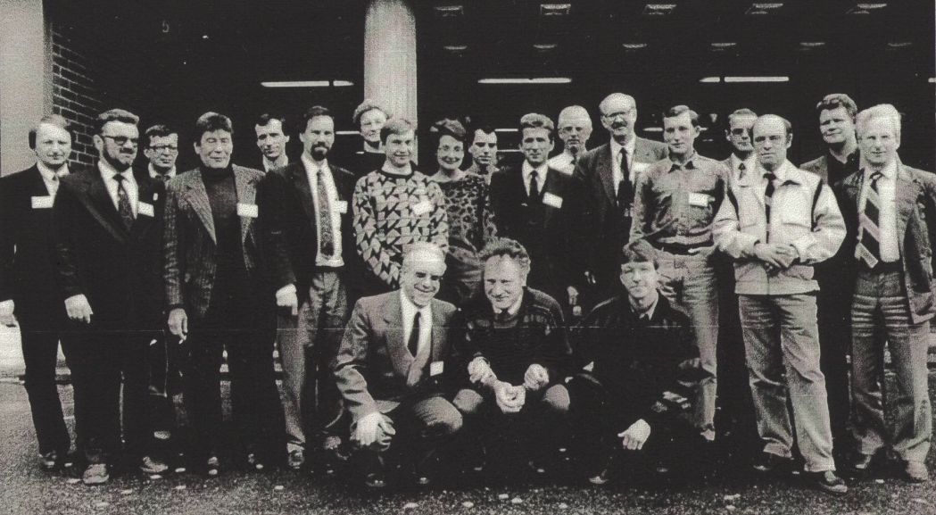
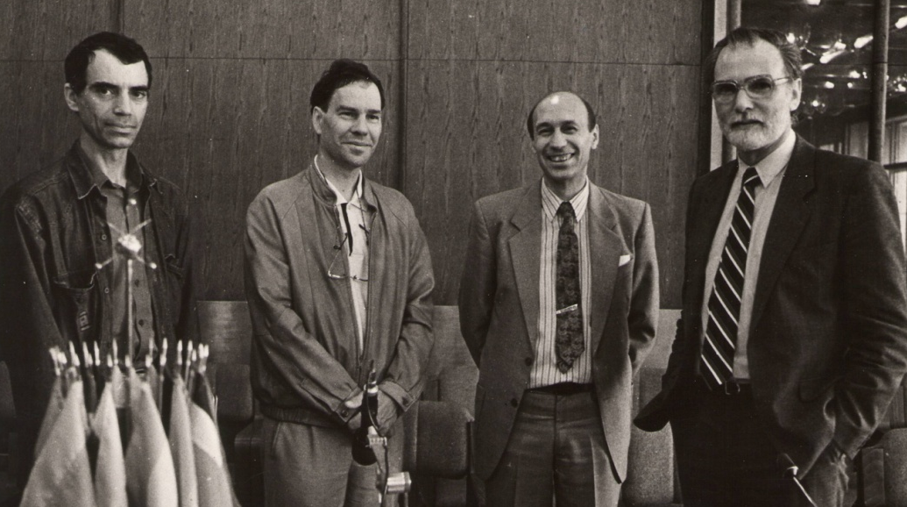
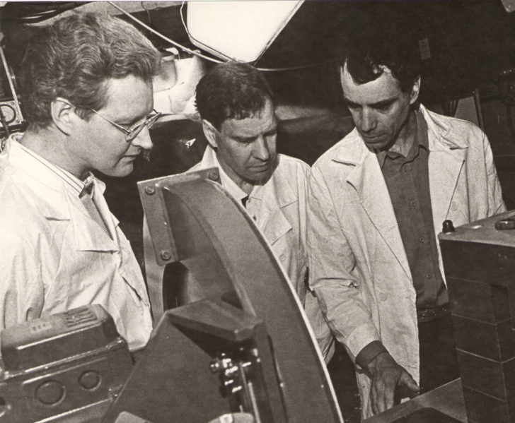
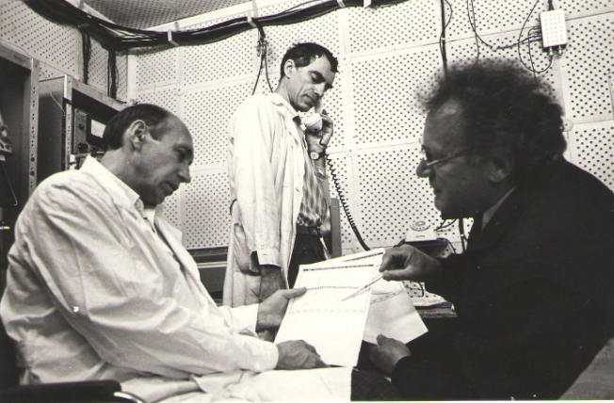
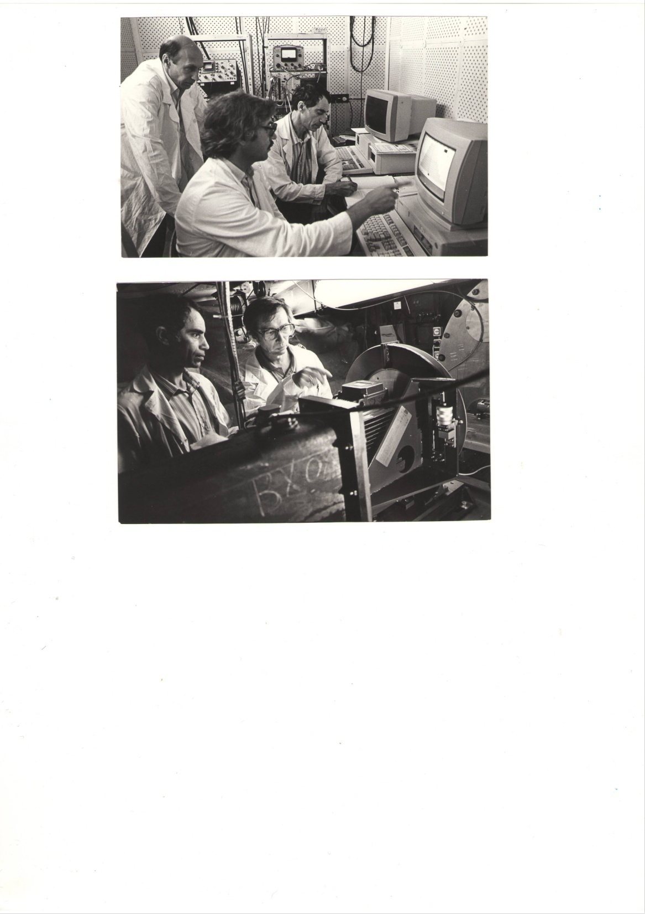
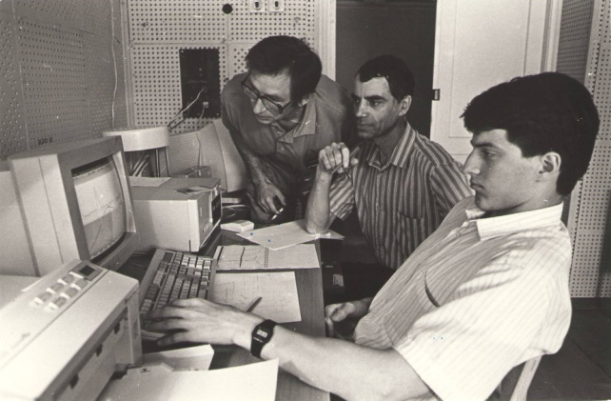
HRFD team: Dubna – Gatchina - Espoo
1989
1992
1992

Slide 5
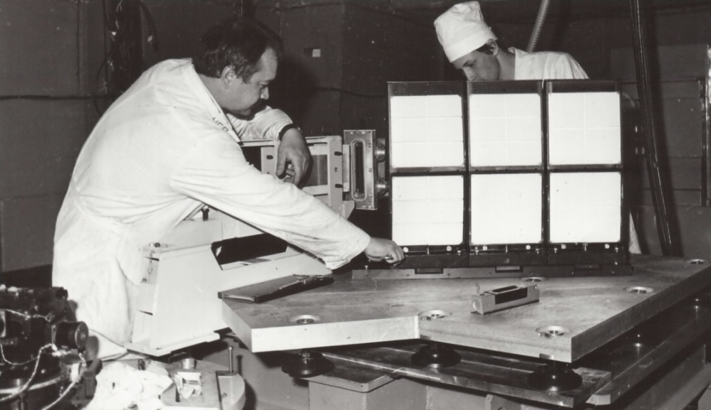
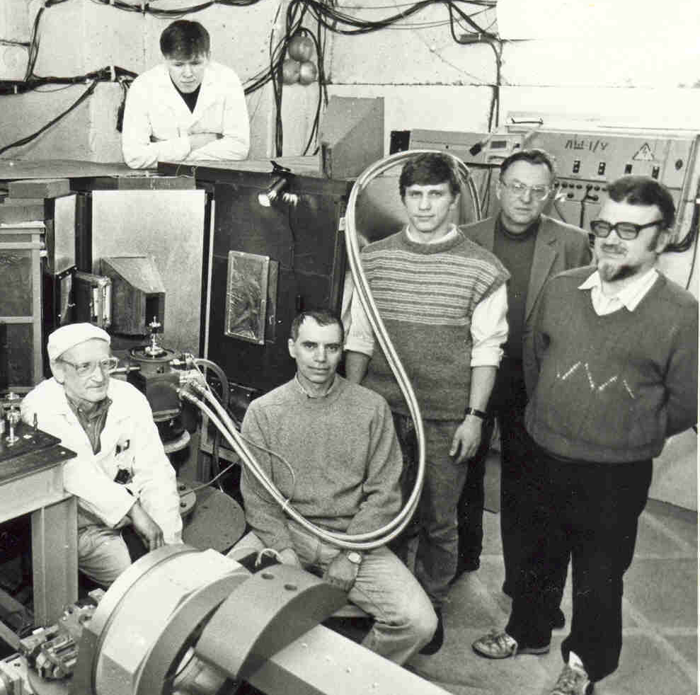
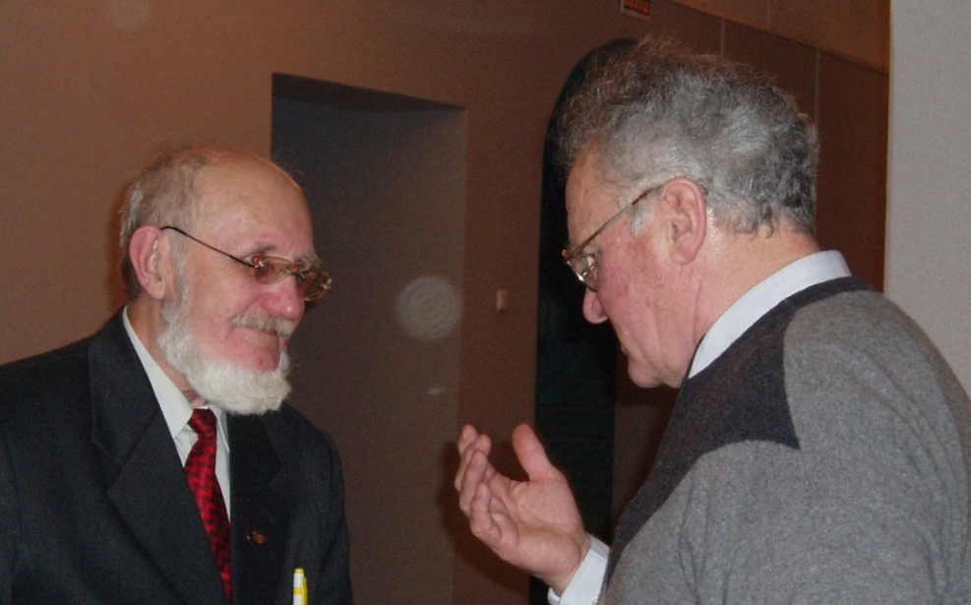
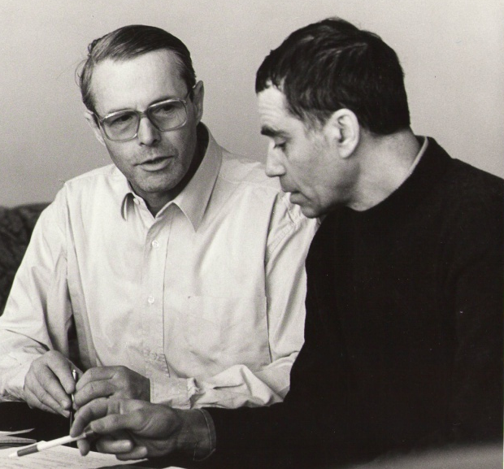
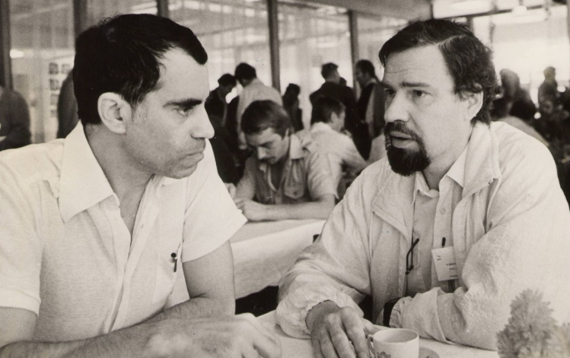
HRFD team: Dubna – Gatchina - Espoo

Slide 6
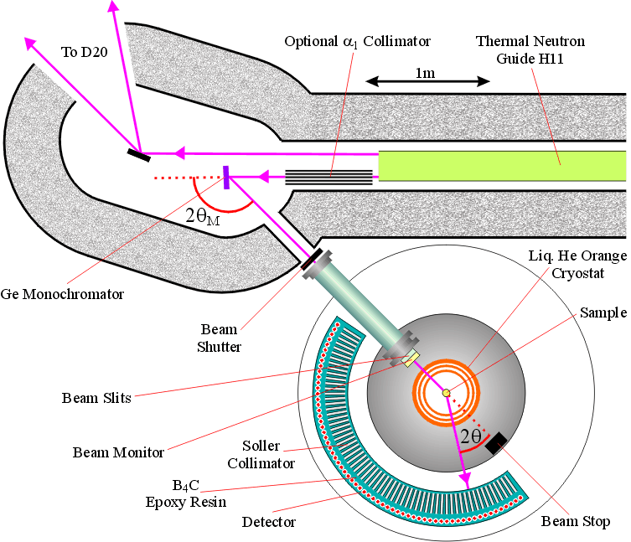
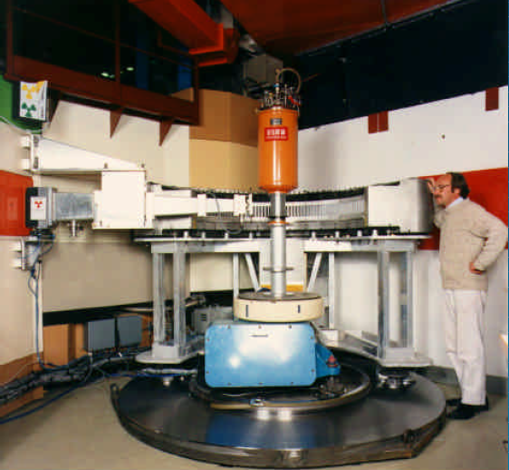
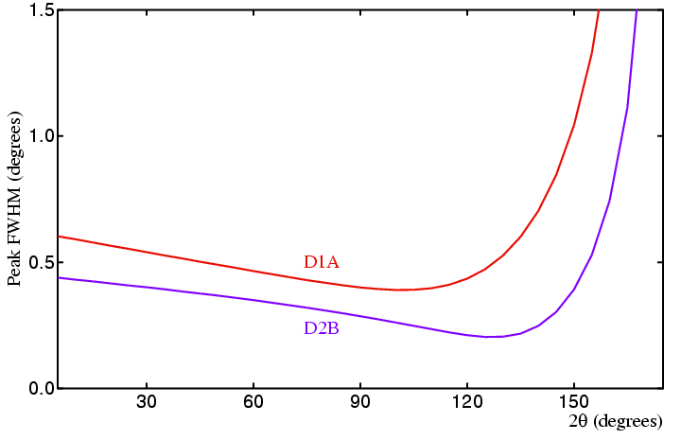
High-resolution neutron diffraction in the late 1980th: D2B (1986)
Alan Hewat at D2B
D2B, ILL
(France)
0.001
Δd/d = Δ(2θ)/(2tgθ)
0.024
0.001

Slide 7
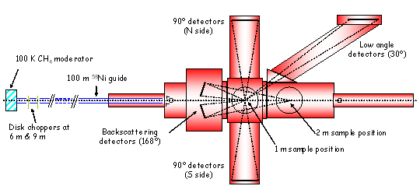
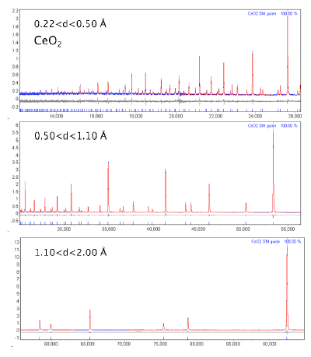
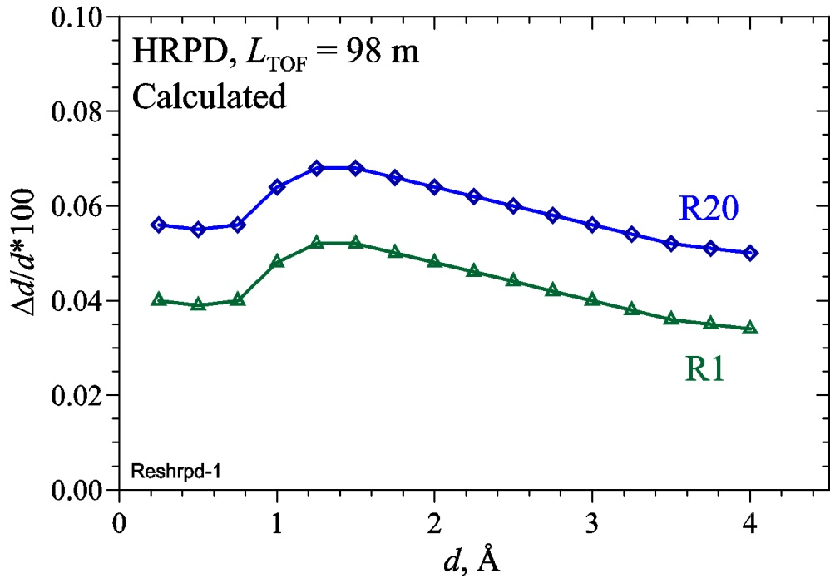
High-resolution neutron diffraction in the late 1980th: HRPD (1986)
HRPD, ISIS (UK)

Slide 8
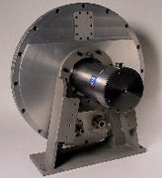
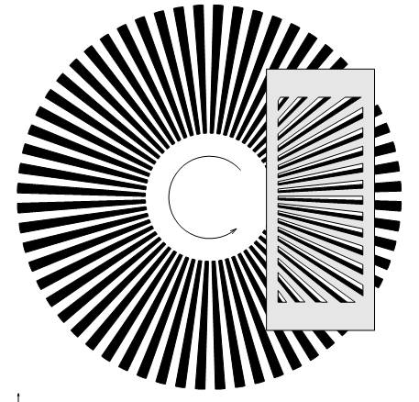
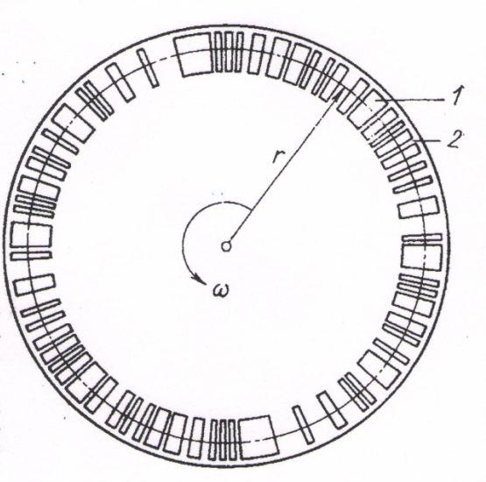
Нейтронная корреляционная дифрактометрия
Steady State Reactor
TOF conventional
TOF correlation
Fermi chopper
Fourier chopper
Statistical chopper
Gd
Al

Slide 9
Корреляционные дифрактометры
1. 1968 pseudo-random FR-2, Karlsruhe closed
2. 1975 Fourier BNL, USA closed
3. 1975 RTOF Fourier Espoo, Finland closed
4. 1984 RTOF Fourier m-SFINKS, PNPI closed
5. 1984 pseudo-random KORA, IBR-2 closed
6. 1988 RTOF Fourier FSS, GKSS transferred to Dubna, IBR-2
7. 1992 RTOF Fourier HRFD, IBR-2 operational
8. 2002 RTOF Fourier FSD, IBR-2 operational
2003 pseudo-random POLDI, PSI operational
2014 pseudo-random Corelli, SNS operational

Slide 10
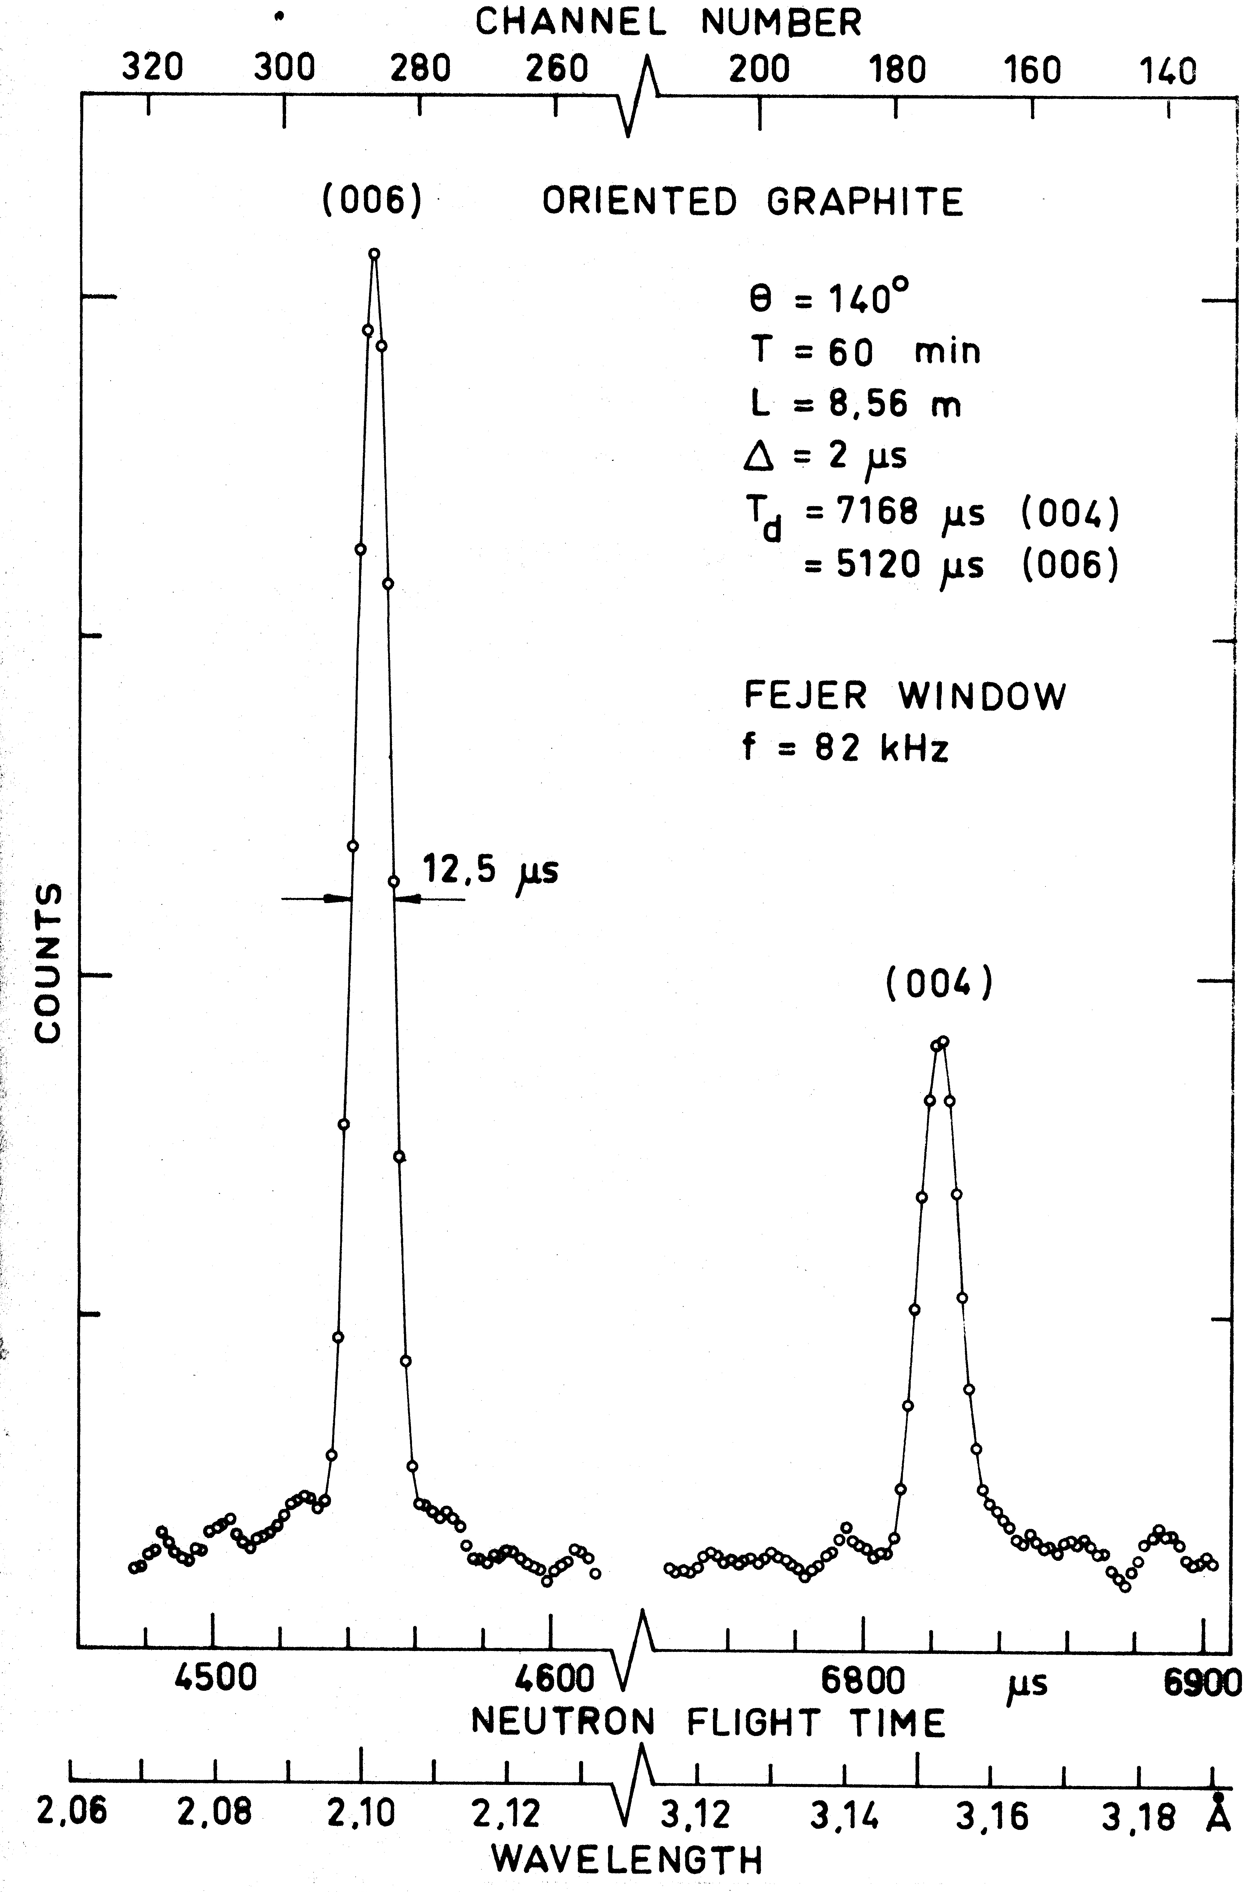
1975: the first realization of RTOF Fourier-method in Espoo
R.Heinonen, P.Hiismaki, A.Piirto et al, New Methods and Techniques in
Neutron Diffraction, Report RCN-234, Petten, 1975, 347
Fourier diffractometer at Espoo (Finland).
The first real diffraction pattern (graphite).
L = 8.6 m, 2θ = 140°, Δd/d ≈ 0.002
Notes:
You see, that the process was not so fast. Between idea (1972) and more or less proper realization (1994) 22 years passed.

Slide 11
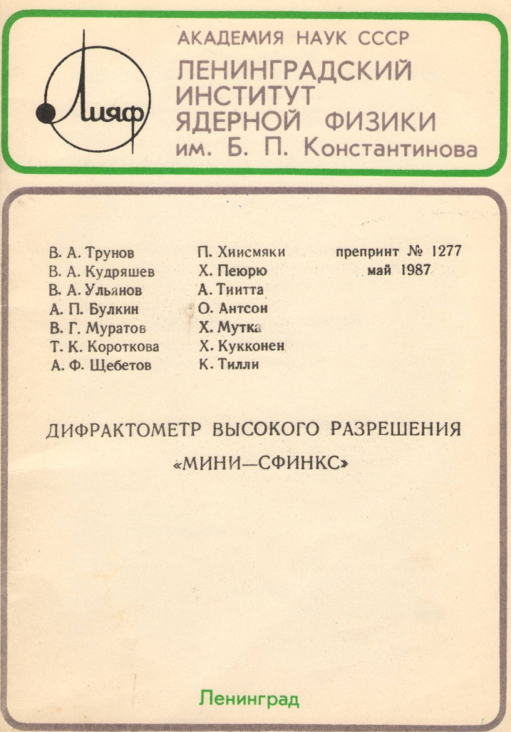
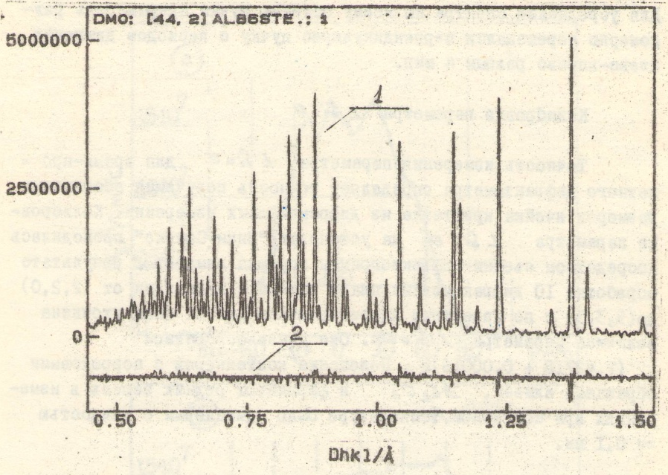
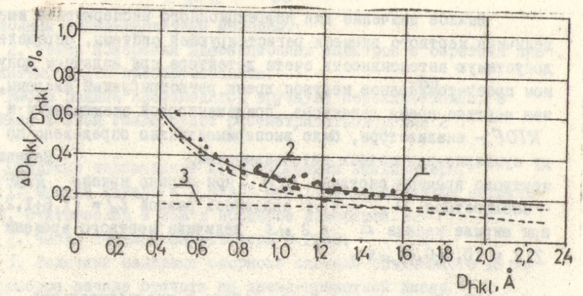
1985: mini-SFINKS diffractometer at PNPI
Образец
Детектор
Фурье-
прерыватель
L = 8.03 m, 2θ = 155°
Al₂O₃
Δd/d ≈ 0.002, d > 1.2 Å
Notes:
You see, that the process was not so fast. Between idea (1972) and more or less proper realization (1994) 22 years passed.

Slide 12
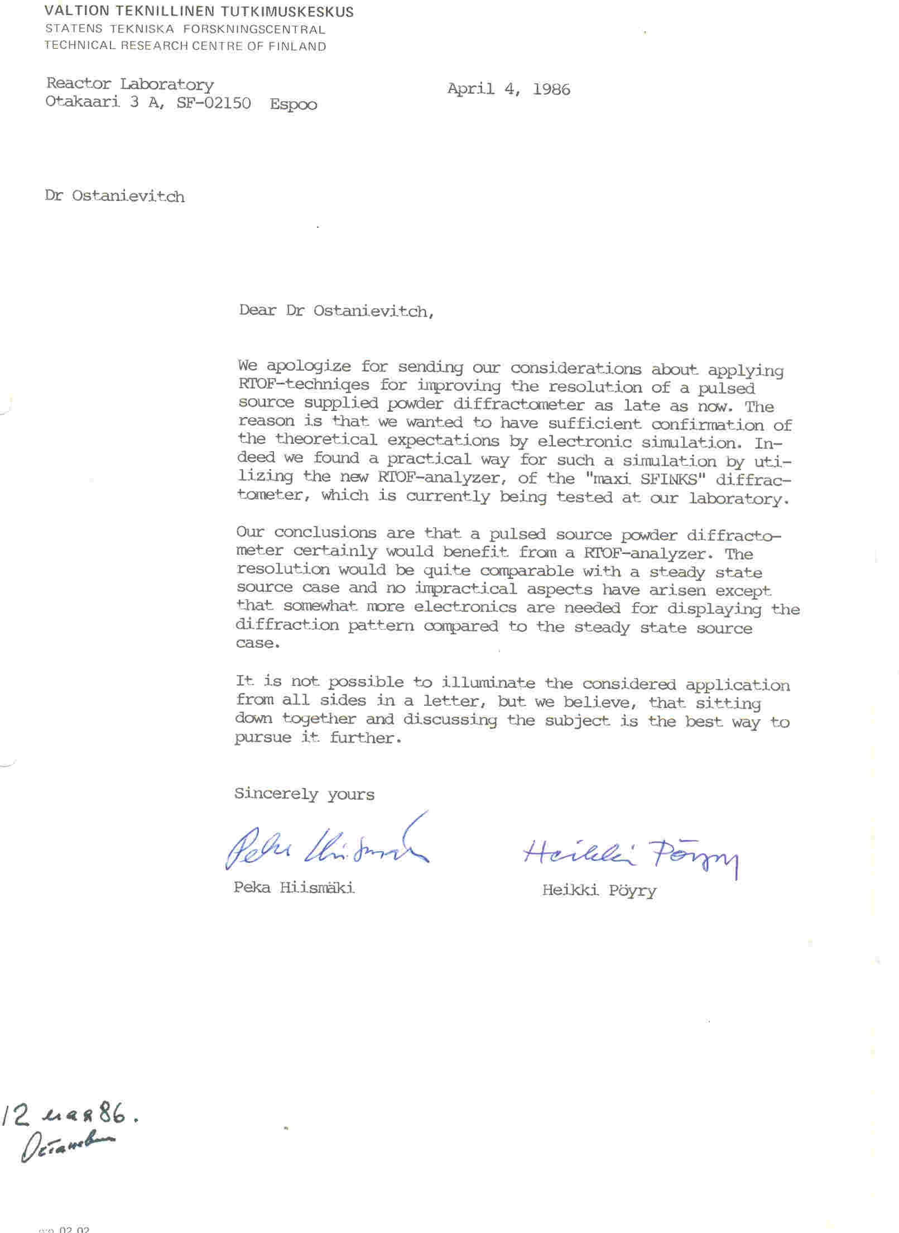
1) Letter from P. Hiismaki and
H. Poyry to Yu.М. Ostanevich:
“Our conclusions are that a pulsed source powder diffractometer certainly would benefit from a RTOF-analyzer”
2) Декабрь 1986, совещание в ЛИЯФ
VTT: P.Hiimaki, H.Pyory, ЛИЯФ: В.А.Трунов
ОИЯИ: Ю.М.Останевич, А.М.Балагуров
3) Июль 1987, Протокол ОИЯИ - ЛИЯФ
о сотрудничестве
4) 1988 – 90: письма И.М.Бортнику, Г.И.Марчуку, Н.А.Черноплекову, А.В.Кулакову, Ю.А.Осипьяну
5) 13.03.1991, протокол ОИЯИ – ЛИЯФ – VTT о совместной работе
6) 28.05.1991, контракт с VTT на 657 К$
Received: May 12, 1986

Slide 13
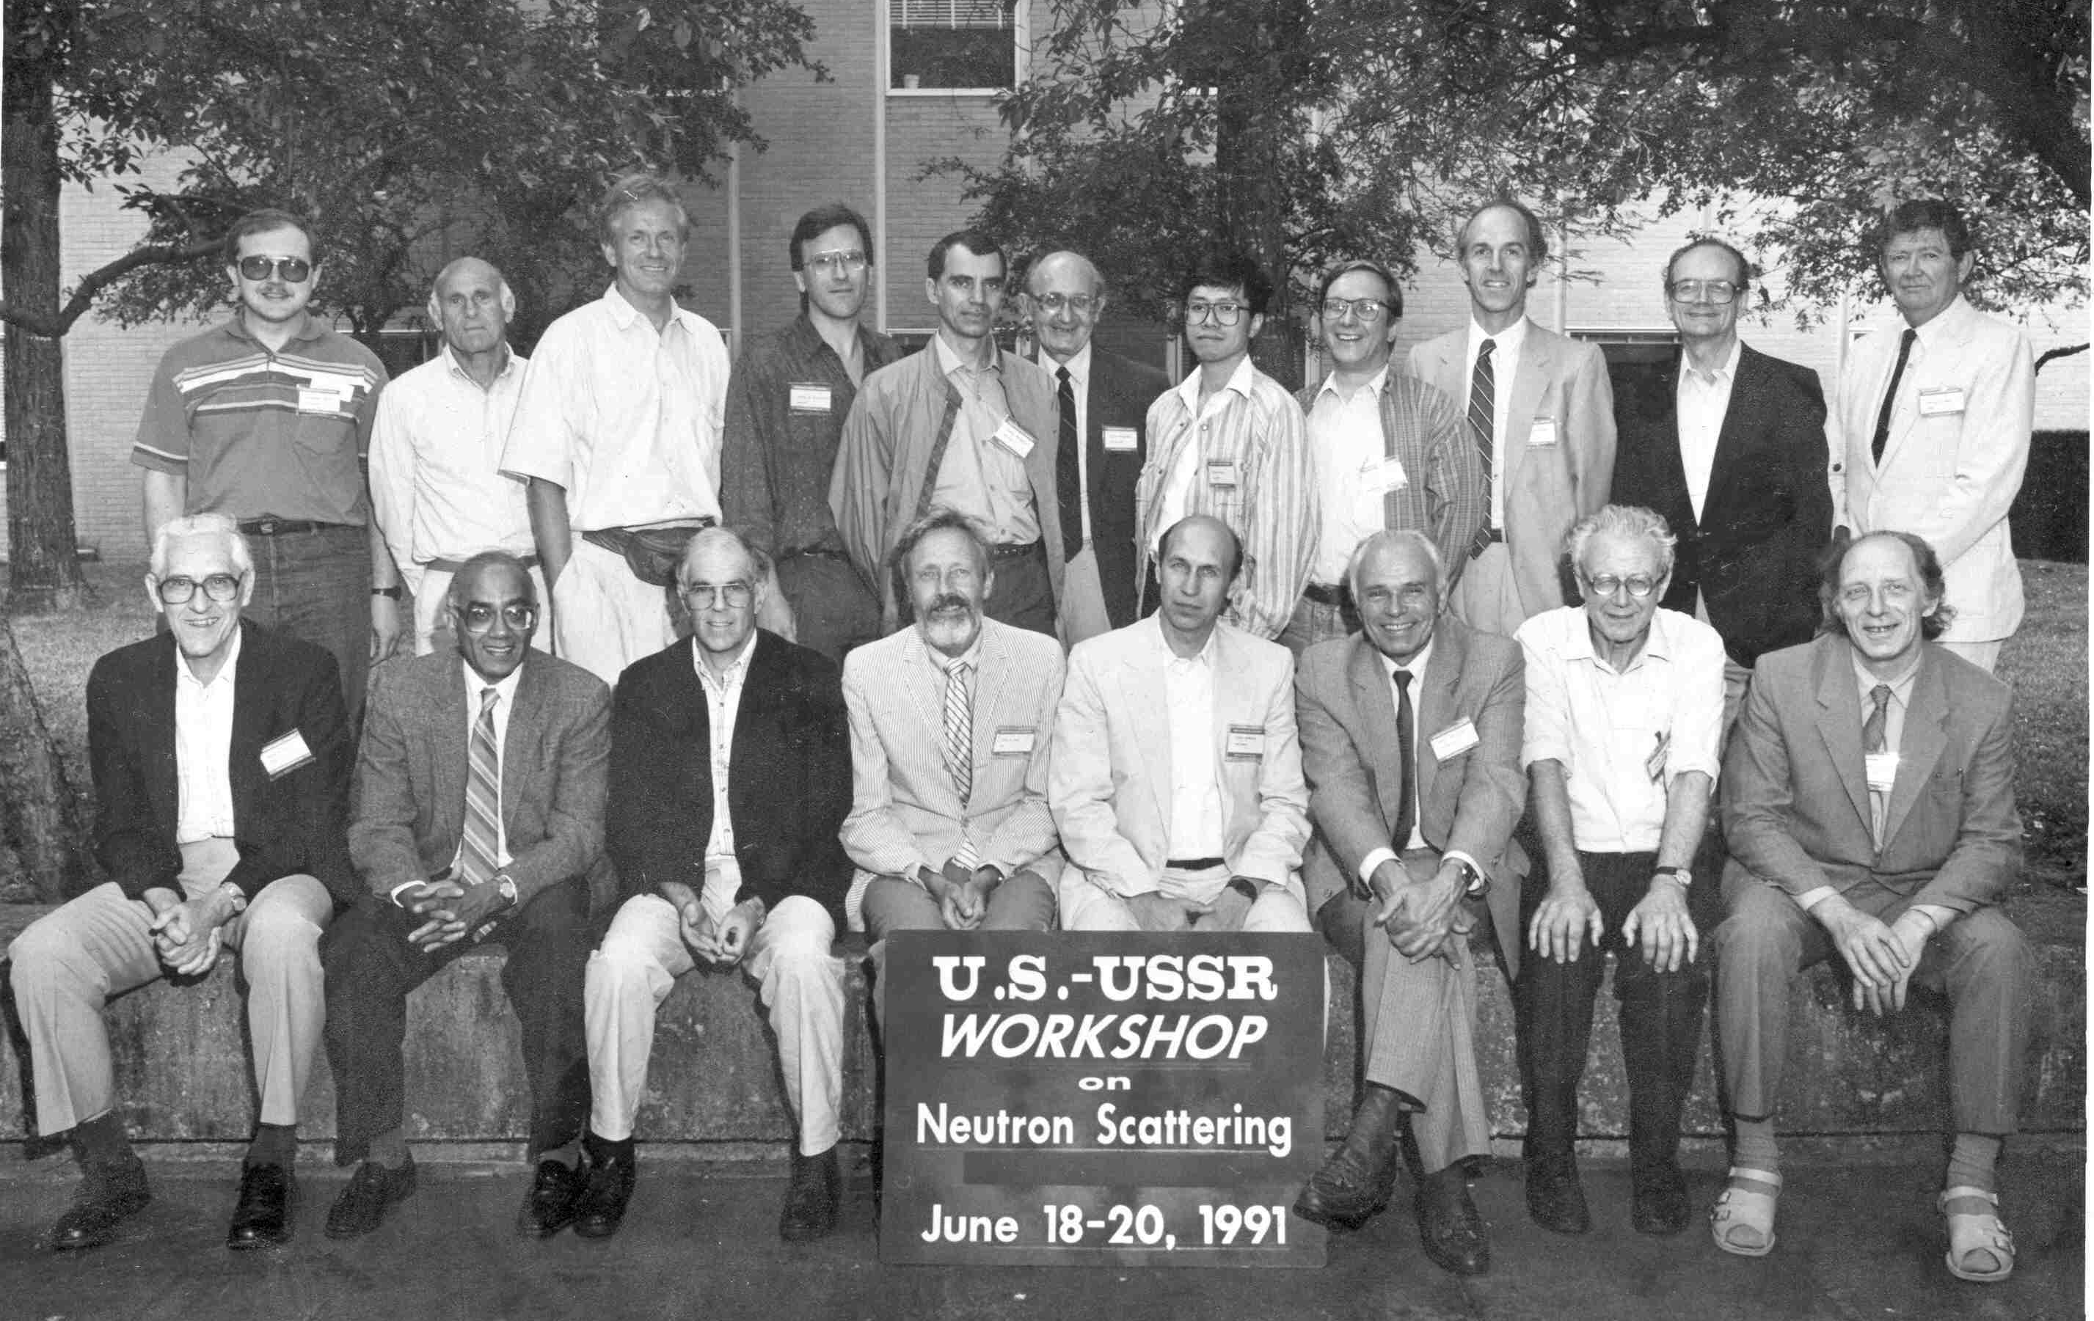
U.S. – USSR (Russia) Workshop on Neutron Scattering
BNL, Upton, New York, June 18 – 20, 1991

Slide 14
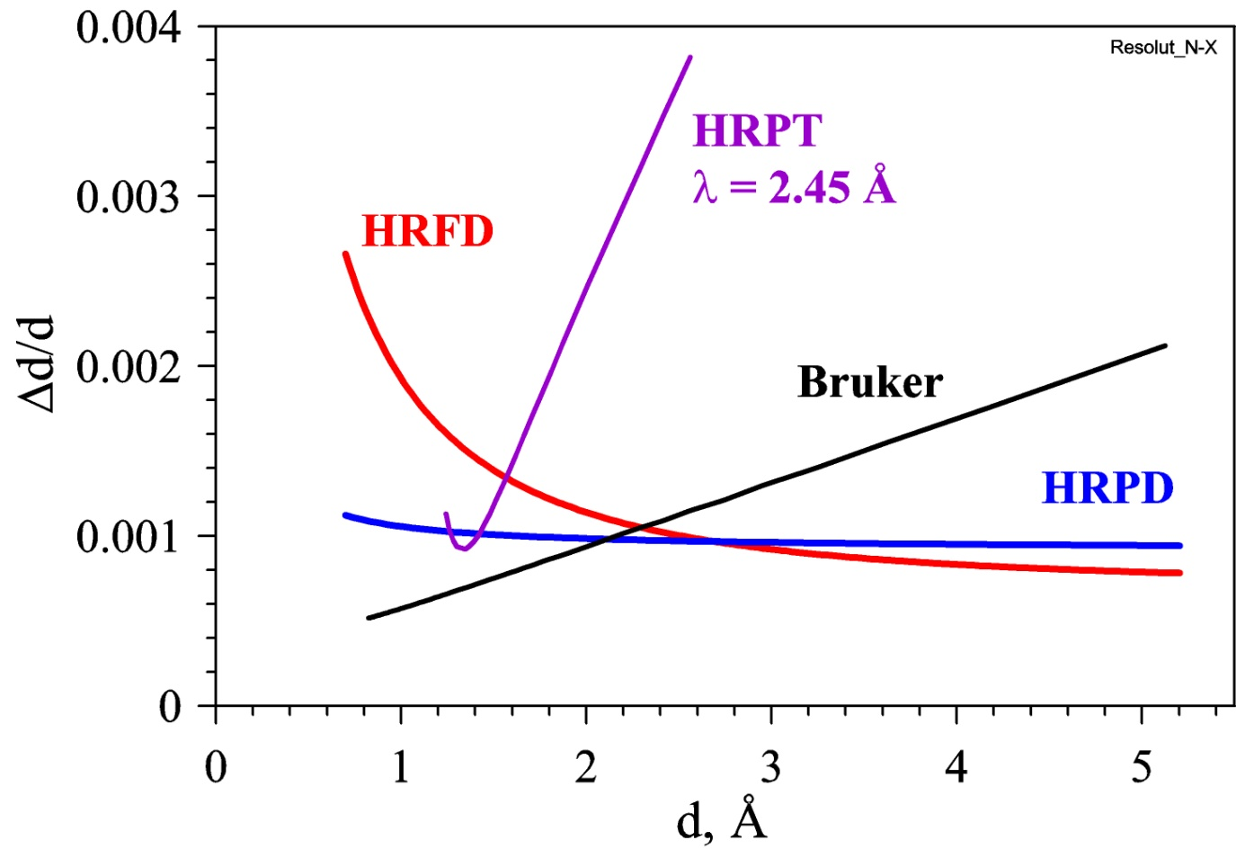
Resolution of a neutron diffractometer
1) λ = Const R(d) is a complicated function with a deep minimum
2) TOF Δt₀ ~ λ → R(d) ≈ Const
3) Fourier Δt₀ ≈ Const → R(d) ≈ [A² + (B/d)²]^{1/2} → A for large d

Slide 15
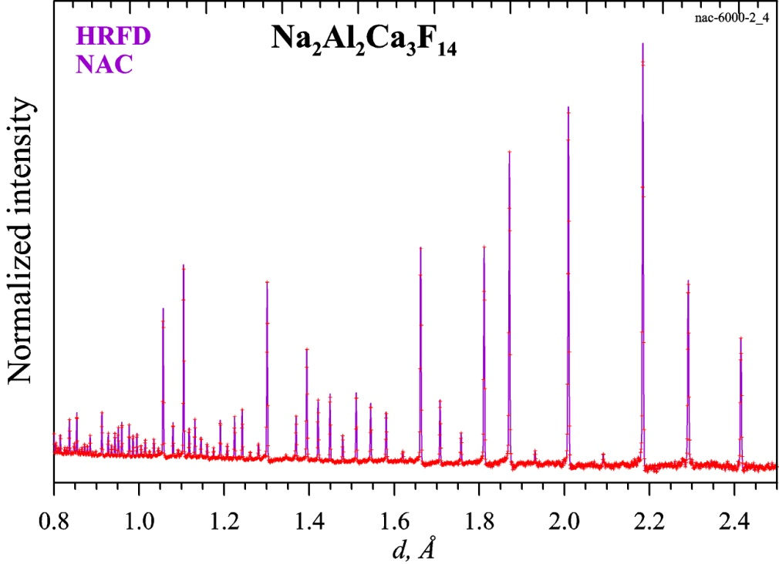
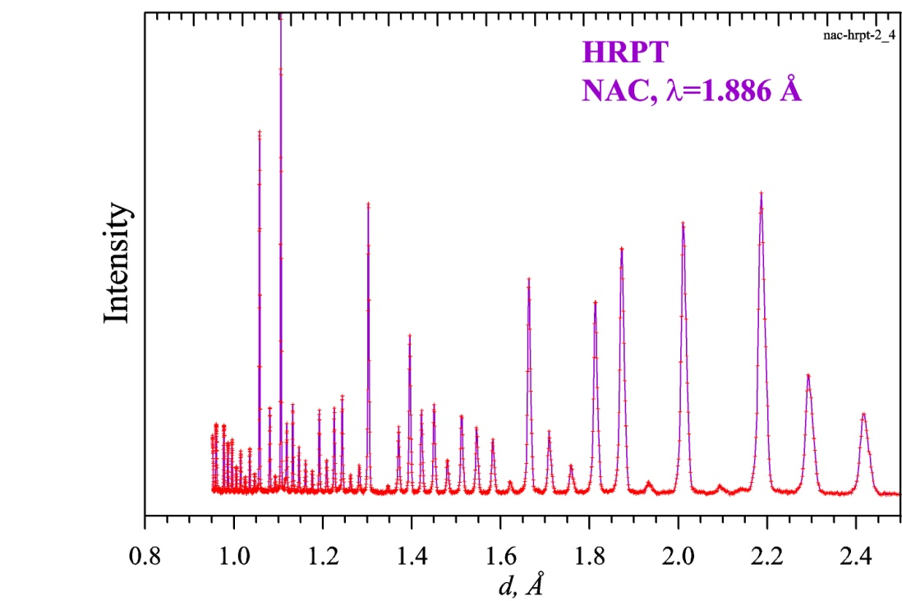
NAC-стандарт (Na₂Al₂Ca₃F₁₄) на TOF- и λ₀ -дифрактометрах
TOF diffractometer HRFD: 2θ₀ = 152°,
wavelength range = 1.2 – 7.2 Å
λ₀ diffractometer HRPT: λ₀ = 1.886 Å,
range of scattering angles = 10 – 165°
15

Slide 16
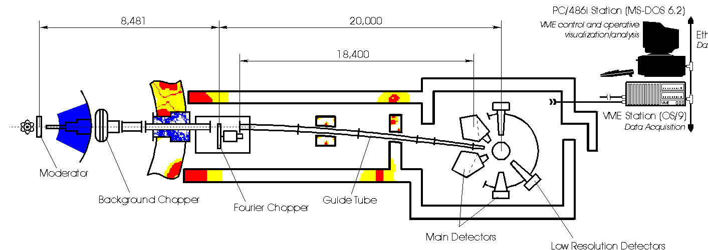
1992: High Resolution Fourier Diffractometer at IBR-2
HRFD (IBR-2): Δt₀ ≈ Const ≈ 10 μs, L ≈ 21 m,
Δt₀/t ≈ 1·10⁻³/d = 5·10⁻⁴ for d = 2 Å
16

Slide 17
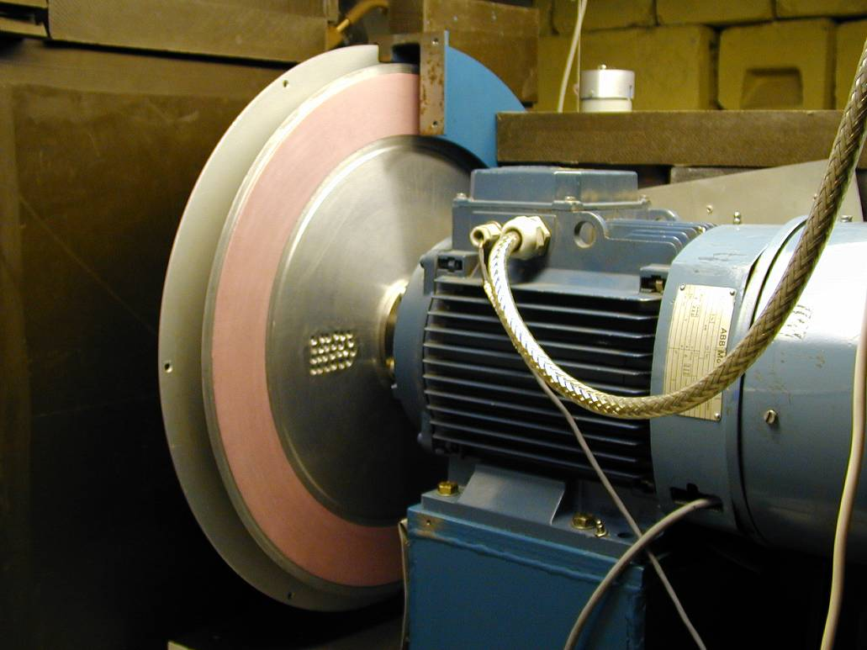
Fast Fourier chopper at HRFD (Dubna)
Rotor (∅ = 50 cm)
0.7 mm
Stator
Dubna chopper:
Al-alloy
∅ = 50 cm
N = 1024
<d> = 0.7 mm
V_{max} = 6000 rpm
Ω = 100 kHz
Δt₀ = down to 10 μs
S_{beam} = 3x20 cm²
Transmission = 25%
7.5 kW motor
Triangular chopper
transmission function:
T(t) ≈ 1 + sin ωt
Binary pick-up signals
for RTOF analyzer

Slide 18
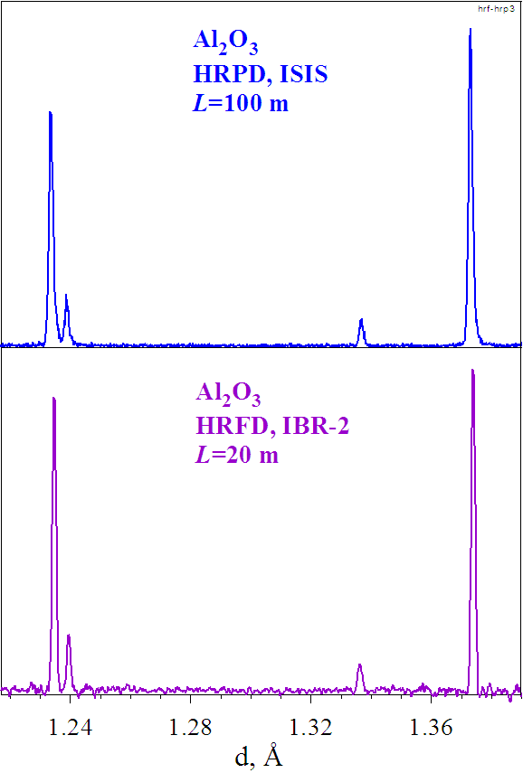
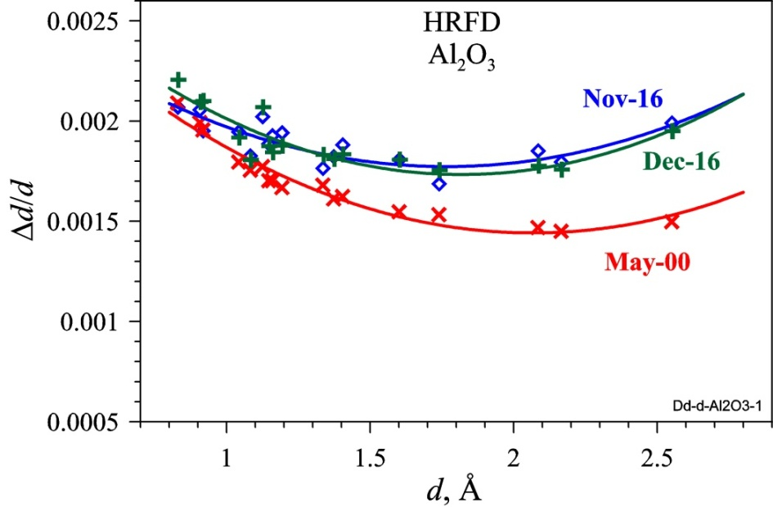
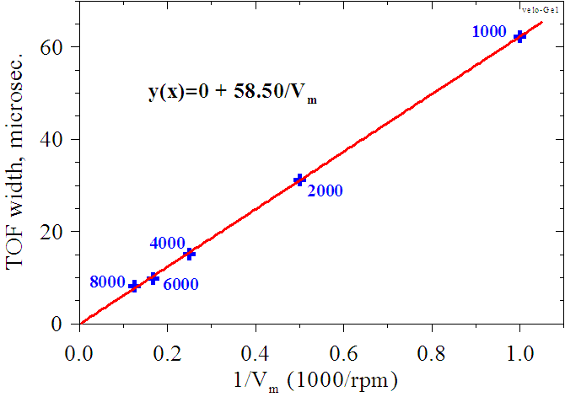
HRFD resolution
V_{max} = 4,000 rpm
L = 20 m
Diffraction patterns of Al₂O₃ measured at ISIS (UK) and IBR-2 (Dubna). Resolution is the same, despite L is 5 times longer at ISIS.
For L=30 m, V_{max}=11,000 rpm: R_{t} = 0.0002,
R = (R_{t}² + R_{g}²)^{1/2} ≈ 0.0003
18

Slide 19
Rietveld analysis of the HRFD data (MRIA package)
Diffraction pattern obtained with NAC-standard

Slide 20
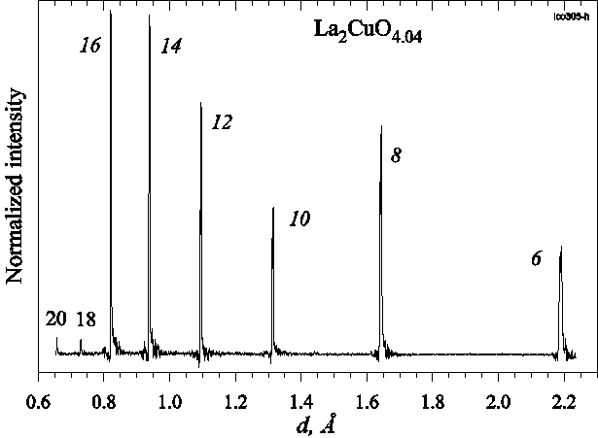
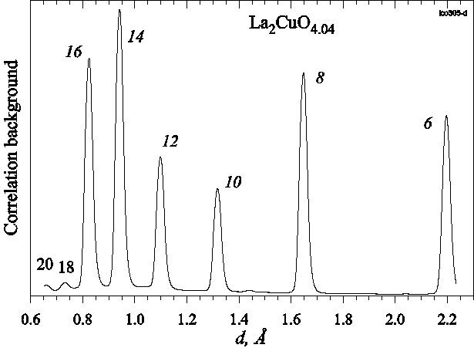
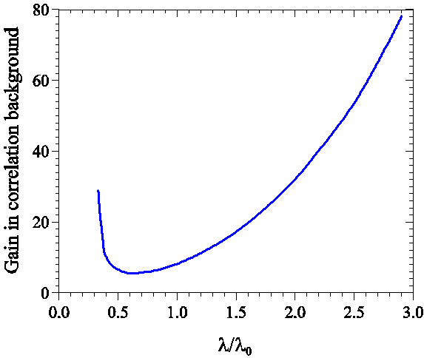
Correlation background
I(t) ~ ± R_{s}(t-τ)R_{c}(t-τ)σ(τ)dτ + c R_{s}(t-τ)σ(τ)dτ + B
Pulsed source: B_{cor}(t) ~ R_{s}(t-τ)σ(τ)dτ Reactor: B_{cor}(t) ~ σ(τ)dτ = Const
R_{c} is Fourier chopper pulse,
R_{s} is source pulse,
B is conventional background
σ is scattering cross-section
Ratio ∼ [ Φ(λ)dλ]⁻¹
Δλ ≈ 0.02λ₀

Slide 21
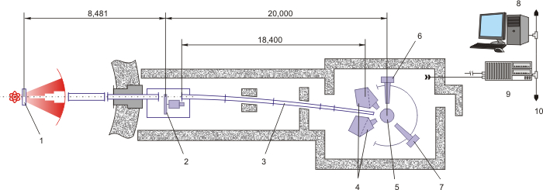
HRFD upgrade
1 – Moderator
2 – Fourier Chopper
3 – Guide Tube
4 – Main Detector
5 – Sample Position
6 – 90°-Detector
7 – PSD Detector
8 –Control and Operative
9 – Data Acquisition
10 –Ethernet Data Transfer
Fourier chopper
(2016)
Neutron guide
(2016)
BS detector
(2020)
Electronics for data acquisition
Software for data processing continuously
Sample environment
Investments 2014-2016: NG (188 KSFr), FCh (102.5K$), Furnace up to 1300ºC (70 K$),
Translation table (15 K$), Refrigerator (70 K$), …
Notes:
The main components of diffractometer are shown on this slide. This is the special neutron chopper – Fourier chopper, curved mirror neutron guide, scintillation detectors and electronics for data acquisition.
Significant part of modernization of electronics components were made in 2014 and 2015
In my talk Ill focus on components which were installed in 2016 (in last year). This is neutron guide and the most important component of HRFD – Fourier chopper.
It has this name because of specific law of his rotation which helps us to collect data at different frequencies of neutron transmisson and use method similar to inverse Fourier transform for recover diffraction pattern.

Slide 22
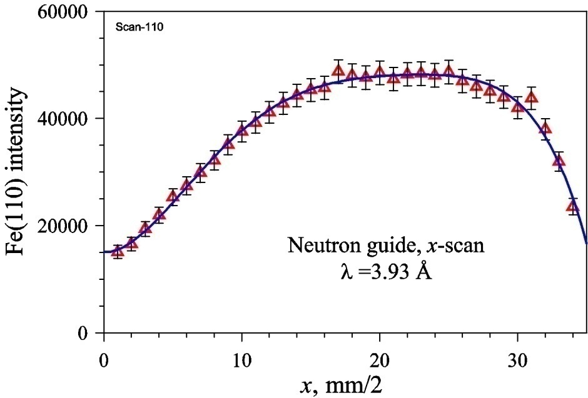
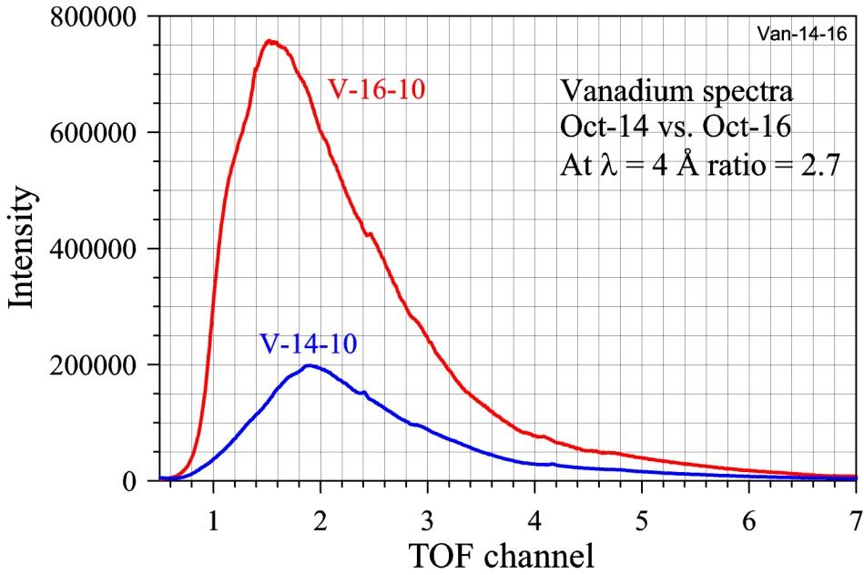
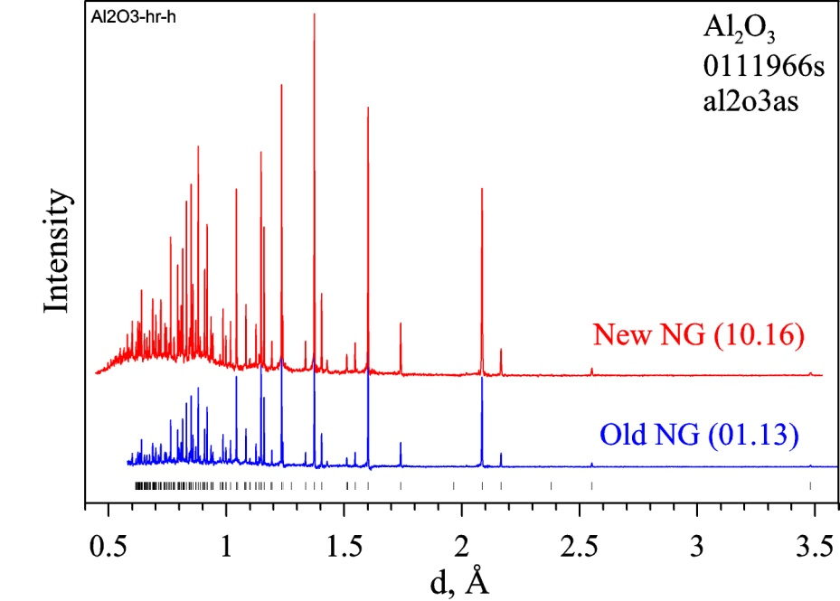
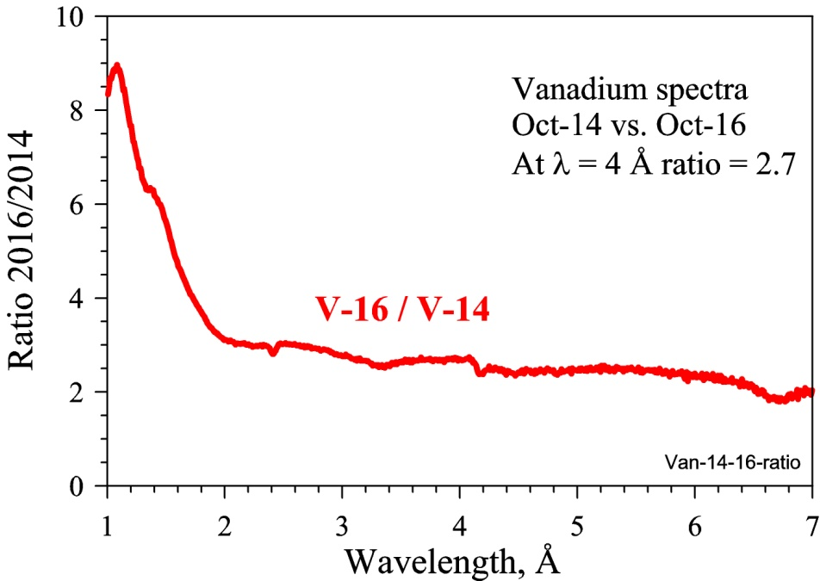
HRFD upgrade: results

Slide 23
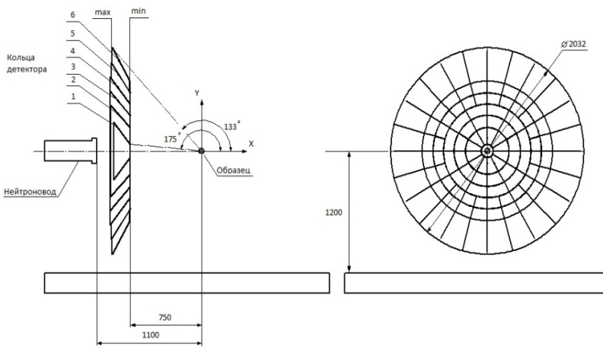




HRFD current upgrade: BS detector, List-mode electronics
∅2032
Efficiency
<f> ~ 85%
130º
Scattering angle
180º
BS detector: ZnS(Ag)/⁶LiF, 2θ = (133-175)°, S ≈ 13 m², Ω ≈ 2.0 sr
List-mode data acquisition

Slide 24
Scientific program – main topics
1. Hg-based HTSC: Physica C(1996), PRB(1997), PRL(1998), PRB(2001)
2. Phase separation in La₂CuO_{4+y}: Письма ЖЭТФ(1996), Physica C(1996), PRB (1998), Кристаллография(1999)
3. LPCM’s: Письма ЖЭТФ(1998), PRB(1999), Eur.Phys.J.(2001), PRB(2001), Physica B(2004), Кристаллография(2006)
5. Brownmillerites: J.Sol.St.Chem.(2001), PRB(2002), Physica B(2004)
4. Sr-based-oxides: ФТТ(2004), Письма ЖЭТФ(2005), Physica B(2006), ЖЭТФ(2008)
5. Manganites: ФТТ(1999), PRB(2000), PRB(2004), Mat.Scien.Ing.(2005), SSC(2006), Письма ЖЭТФ(2006), Кристаллография(2007), ЖЭТФ(2011)
6. Cobaltites: J.Sol.St.Chem.(1999), JMMM(2006), Письма ЖЭТФ(2008, 2011)
7. Hexaferrites: Кристаллография(2015), JMMM(2015, 16, 17), JALCOM(2016)
8. Li-ion batteries: Успехи химии(2014), JPS(2014), Электрохимия(2017), JPS(2017)
9. Fe-based alloys: Materials&Design(2016), JALCOM(2016, 16, 17), Materials Lett.(2016), Письма ЖЭТФ(2016), J. Appl. Cryst.(2017), Acta Materialia(2017)

Slide 25



January-2017, Paper in Nature Communications

Slide 26


Fe-xGa (Galfenol) with Giant Magnetostriction
Fe - Pt, Fe - Pd,
Fe - Со, Mn - Sb,
Mn - Cu - Bi,
Fe - Rh
Δl/l = λ
∼ 5×10⁻⁶ Fe
< 30×10⁻⁶ Fe-Cr
< 60×10⁻⁶ Fe-Al
Terfenol – intermetallic compound:
Tb₀₃Dy₀₇Fe_{1.92}
Magnetostriction (James Joule, 1842)
converts magnetic energy into mechanical one
Inverse magnetostrictive effect is known as Villari effect (Emilio Villari, 1865).
Change in shape is elastic (no fatigue)

Slide 27


Fe-xGa phase diagrams
Equilibrium
Non equilibrium
Fe-xGa
Fe-25Ga
Fe-50Ga
Fe-25Ga
Fe-25Ga
A2
D0₃
B2
L1₂
D0₁₉

Slide 28


Fe-27Ga на HRFD: типичные дифракционные спектры
Высокое разрешение, Δd/d ≈ 0.0015, t_{s} = 1 час
Среднее разрешение, Δd/d ≈ 0.015, t_{s} = 1 мин
Структурные фазы: D0₃ (упоряд.), B2 (частично упоряд.), A2 (неупоряд.)
Основные пики (A2): h + k + l = 4n
Основные пики при Т > 550ºС: (B2, A2): h + k + l = 2n
Сверхструктурные пики: (D0₃, B2, A2): h + k + l = 2n + 1

Slide 29

Структурные фазовые переходы в сплаве Fe-27Ga при нагревании от комнатной температуры до 850°С
А2, Im3m
a ≈ 2.96 Å
D0₁₉, P6₃/mmc
a ≈ 5.28 Å, c ≈ 4.28 Å
L1₂, Pm3m
a ≈ 3.72 Å
D0₃, Fm3m
a ≈ 5.83 Å
D0₃ → A2 → L1₂ → D0₁₉ → A2

Slide 30

Internal friction and 3D visualization of neutron diffraction pattern evolution for Fe-Al, Fe-Ga, and Fe-Ge samples at continuous heating
Fe-27Al
Fe-27Ga
Fe-27Ge

Slide 31


Анизотропные микродеформации решетки
Образцы Fe-27Ga, предварительный отжиг при 400°С в течение:
(1) 200 (2) 350 (3) 600 минут
Доля фазы L1₂: (1) – 4% (2) – 18% (3) – 69%

Slide 32



Microstructure by TOF technique: size and stress effects
(Williamson – Hall plot in d-scale)
W² = C₁ + C₂d ² + C₃d ² + C₄d ⁴
Resolution function of
TOF-diffractometer
Stress effect
C₃ ~ (2ε)² ~ (2Δa/a)²
Size effect
C₄ ~ (1/L)²
Standard samples (NAC, Al₂O₃) without stresses
Stress effect in CaCuMn₆O₁₂
Size effect in
nanostructured Ni
32

Slide 33




Анизотропные микродеформации решетки
D0₃
L1₂
(Δd)² = C₁ + C₂⋅d² + C₃⋅d², + C₄⋅d⁴
C₁, C₂ - resolution, C₃ = (2ε)², C₄ = (1/L)²
(Δd)² = C₁ + C₂⋅d² + C₃(A - BΓ)⋅d²,
Γ = (h²k² + h²l² + k²l²)/(h² + k² + l²)²
(Δd_{ε})² = (C₃A – C₃BΓ)⋅d²
D0₃
L1₂

Slide 34

Кластерное упорядочение в составах Fe-Al(Cr)
D0₃ → B2 → А2
А2 → B2 → D0₃
Структурные фазы:
D0₃ (упорядоченная), пик (111)
B2 (частично упорядоченная), пик (200)
A2 (неупорядоченная), пик (220)

Slide 35




Основные и сверхструктурные пики в составах Fe-Al
Перед нагревом
После охлаждения

Slide 36

Модель антифазных доменов
F.W. Jones, C. Sykes (1938) “Atomic rearrangement process in the copper-gold alloy Cu₃Au”
A.J.C. Wilson (1943) “The reflexion of X-rays from the ‘anti-phase nuclei’ of AuCu₃”
В.И. Иверонова, Г.П. Ревкевич (1978) “Теория рассеяния рентгеновских лучей”

Slide 37





Модель антифазных доменов
f ~ F· + F·e^{iπh}·
I~|F|²·sin²(πxN)/sin²(πx)·[1+exp(iπh₀)·cos(πxN)]
Fundamental
peak, h = 2n
W ~ 1/L_{t} = 1/N
Superstructural
peak, h = 2n+1
W ~ 1/L_{c} = 2/N

Slide 38
Модель дисперсных кластеров
А.М. Балагуров, И.А. Бобриков, Б. Мухаметулы, С.В. Сумников, И.С. Головин
“Когерентное кластерное упорядочение атомов в интерметаллиде Fe-27Al”
Письма в ЖЭТФ 104(8) (2016) 560-567.

Slide 39


Модель дисперсных кластеров
f ~ <F>·Σ_{n}[exp(2πihn)] + (F - <F>)·Σ_{m}[exp(2πihm)]
Fundamental peak:
<F>=<b> + <b>exp(πih₀) = 2<b> (h₀=2n), = 0, (h₀=2n+1), <b> = (b_{A} + b_{B})/2
W ≈ 1/L_{t}
Superstructural peak:
F - <F>=b_{A}+b_{B}exp(πih₀) – [<b>+<b>exp(πih₀)] = 0 (h₀=2n), = (b_{A} - b_{B}) (h₀=2n+1)
W ≈ 1/L_{c}

Slide 40



Proc. Phys. Soc. 52 (1940)
Proc. Roy. Soc. A181 (1943)
TEM image of Fe–26 at.%Al: antiphase D0₃ domains in annealed at 573K state

Slide 41




Монокристалл Fe-26.5Al, плоскости (hhh) и (hh0)
Fundamental peaks with h + k + l = 2n; i.e. matrix is B2, clusters are D0₃ phases

Slide 42



Монокристалл Fe-26.5Al, (hhh), нагрев – охлаждение, t_{s} = 1 min
Нагрев, 2.2 К/мин
Охлаждение, 20 К/мин

Slide 43




Монокристалл Fe-26.5Al, (hhh), нагрев, t_{s} = 1 min
Ширины пиков
Размер кластеров
W² = W₀² + (2ε)²⋅d² + (1/L_{c})⋅d⁴
ε ≈ const, L_{c} is growing up
Интенсивности пиков
I ~ V_{c}·F²·λ⁴·exp[-B(T)/2d²]·y(λ)
Параметр порядка
F_{f} = 3b_{Fe} + b_{Al}
F_{s} = ξ·(b_{Fe} – b_{Al})
I_{s} ~ ξ²·L_{c}³·е^{-B(T)} W ~ 1/L_{c}
ξ ~ (I_{s}·W³)^{1/2}·е^{B(T)}

Slide 44


Государственная премия Российской Федерации
за 2000 год в области науки и техники
“Разработка и реализация новых методов структурной нейтронографии по времени пролета с использованием импульсных и стационарных реакторов”
В.Л.Аксенов, А.М.Балагуров, В.В.Нитц, Ю.М.Останевич (ОИЯИ)
В.А.Кудряшев, В.А.Трунов (ПИЯФ РАН)
В.П.Глазков, В.А.Соменков (РНЦ КИ)

Slide 45
Conclusions
  There exists positive experience of exploitation of the Fourier diffractometer at a long-pulse neutron source
  The realistic further development of the Fourier technique is planning
  The Fourier technique could be the most prospective one for construction of ultra-high resolution diffractometer at long-pulse neutron source
Notes:
There is no problem now to measure FM/AFM coexistence with very good quality. For instance, here you see the diffraction pattern of this composition at 150 K, where there is no magnetic intensity. At 95 K AFM peaks appeared, at 80 K we see appearance of FM intensity with some evolution at low T.

Slide 46
Thank you

Slide 47
High-resolution neutron powder diffraction: (Δd/d)_{min} ≤ 0.002
Continuous Sources
Short Pulse Sources
Long Pulse Sources
W = 10 – 100 MW
Δt₀ = ∞
W = 0.1 – 1.5 MW
Δt₀ ≈ (15 – 30)∙λ μs
W = 2 – 5 MW
Δt₀ ≈ (300 – 2800) μs
λ = const
diffractometer
2θ_{m} ≥ 120°
α₁ ≈ α₂ ≈ 10'
TOF
diffractometer
L ≥ 60 m
2θ ≈ 160°
TOF-chopper
(Fourier / Fermi)
diffractometer
L = 20 - 200 m
2θ ≈ 160°
D2B (ILL), 0.0005
HRPT (PSI), 0.0009
…
HRPD (RAL), 0.0005
PG3 (SNS), 0.001
…
HRFD (FLNP), 0.0005
HRPD (ESS), 0.0003
…
47
Notes:
47

Slide 48
RTOF Fourier technique for diffraction
Good news:
  All positive features of TOF diffractometer
  Highest resolution at shortest flight path
  Resolution is only slightly depends on d_{hkl}
  Large d-spacing range, no overlapping problem
Bad news:
Small d-spacings (<0.6 Å) can not be measured
TOF component of the resolution function is ~1/d
Correlation background can not be excluded
Peak shape can be hardly modeled analytically
Long-term mechanical stability is a problem
  All units (except detector) are very cheap
Complicated for understanding
Notes:
There is no problem now to measure FM/AFM coexistence with very good quality. For instance, here you see the diffraction pattern of this composition at 150 K, where there is no magnetic intensity. At 95 K AFM peaks appeared, at 80 K we see appearance of FM intensity with some evolution at low T.

Slide 49
Fast Fourier chopper technique for high-resolution neutron diffraction
Step 1 (1968)
J.F.Colwel, P.H.Miller, and W.L.Whittemore (San Diego, USA) “A New High-Efficiency
Time-of-Flight System” Neutron Inelastic Scattering, IAEA, Vienna, 1968, p. 429.
Step 2 (1971)
A.C.Nunes, R.Nathans, B.P.Schoenborn (BNL, USA) “Neutron Fourier Chopper for Single
Crystal Reflectivity Measurements” Acta Cryst. A27 (1971) 284.
Step 3 (1972)
P.Hiismaki (VTT, Finland) “Inverse Time-of-Flight Method” Neutron Inelastic Scattering,
IAEA, Grenoble, 1972, p. 803.
Steps 4 – 7: operational high-resolution Fourier diffractometers:
mini-SFINKS (PNPI, Russia, 1985), steady-state reactor, Δd/d ≈ 0.002 (not now)
FSS (GKSS, Germany, 1994), steady-state reactor, Δd/d ≈ 0.004 (not now)
HRFD (JINR, Russia, 1994), pulsed reactor, Δd/d ≤ 0.0009
FSD (JINR, Russia, 2002), pulsed reactor, Δd/d ≤ 0.002

Slide 50




Size effects in NiO nanopowders
Widths of nuclear and magnetic peaks in diffraction patterns of NiO with 138 nm and 100 nm crystallite size
Sample | S4, 1500 nm | S19, 138 nm | S18, 100 nm | S16, 13 nm
L_{nuc}, nm | > 350 | 102(3) | 98(4) | 11(2)
L_{mag}, nm | > 350 | 102(3) | 41(3) | 10(2)
L_{nuc} / L_{mag} ≈ 2.5
Diffraction patterns of NiO with 13 nm and 138 nm crystallite size
“Neutron diffraction study of microstructural and magnetic effects in fine particle NiO powders” phys. stat. solidi (B), 2016.
Notes:
50

Slide 51




Phase transitions in NiO and MnO
“Magnetostructural Phase Transitions in NiO and MnO: Neutron Diffraction Data” JETP Letters, 2016.
Notes:
There is no problem now to measure FM/AFM coexistence with very good quality. For instance, here you see the diffraction pattern of this composition at 150 K, where there is no magnetic intensity. At 95 K AFM peaks appeared, at 80 K we see appearance of FM intensity with some evolution at low T.

Slide 52





Microstructure of nanosized NbC_{0.9} powders milled in 1, 5, 10, 15 hours
Rietveld refinement of NbC-5h patterns. Positions of components are shifted.
Lattice parameter as a function of milling time for x-ray data and
2 component neutron distribution.
Rietveld refinement of NbC-0h & NbC-5h patterns. Two-component model was used for the second pattern.
Size distributions for 2 components of NbC-5h. Average sizes are 25.6 and 70.6 nm.
52
52

Slide 53

High Resolution Fourier Diffractometer (HRFD) in Dubna

Slide 54



POLDI (SINQ): TOF-diffractometer with multiple pulse overlap
L (chopper – sample) = 11.8 m
Chopper disk: 15000 rpm,
32 slits, 4mm width, Δt₀ = 8 μs
Sample table and detector

Slide 55


Elastic Diffuse Scattering Spectrometer CORELLI / BL-9 / SNS
Elastic diffuse scattering from an Fe₇₂Pt₂₈ Invar single crystal. The butterfly shape scattering near the Bragg peaks is from short-range correlations (2 days).
Visual Overview of the CORELLI Instrument

