Slide 1
Parameters of the new diffractometer TEX
Responsible: Yu.Kibalin, I.Golosovsky

Slide 2
During the last meeting it was decided
Texture measurements should not be performed on the hot neutron source
Two options to solve problem
1. Move the TEX diffractometer on another channel.
2. Texture investigations are no longer part of the scientific case of the TEX diffractometer.

Slide 3
Scientific case (hot neutron source)
Structural phase transitions;
Structural disorder;
Structure investigations of liquids and amorphous materials;
Structural studies of biological objects;
Refinement of crystal and magnetic structure;
Atomic anharmonicity;
Thermal diffuse scattering;
Resonance scattering;

Slide 4
Scientific case (thermal neutrons)
Structural phase transitions;
Structural disorder;
Structure investigations of liquids and amorphous materials;
Structural studies of biological objects;
Refinement of crystal and magnetic structure;
Atomic anharmonicity;
Thermal diffuse scattering;
Resonance scattering;
Texture investigation

Slide 5
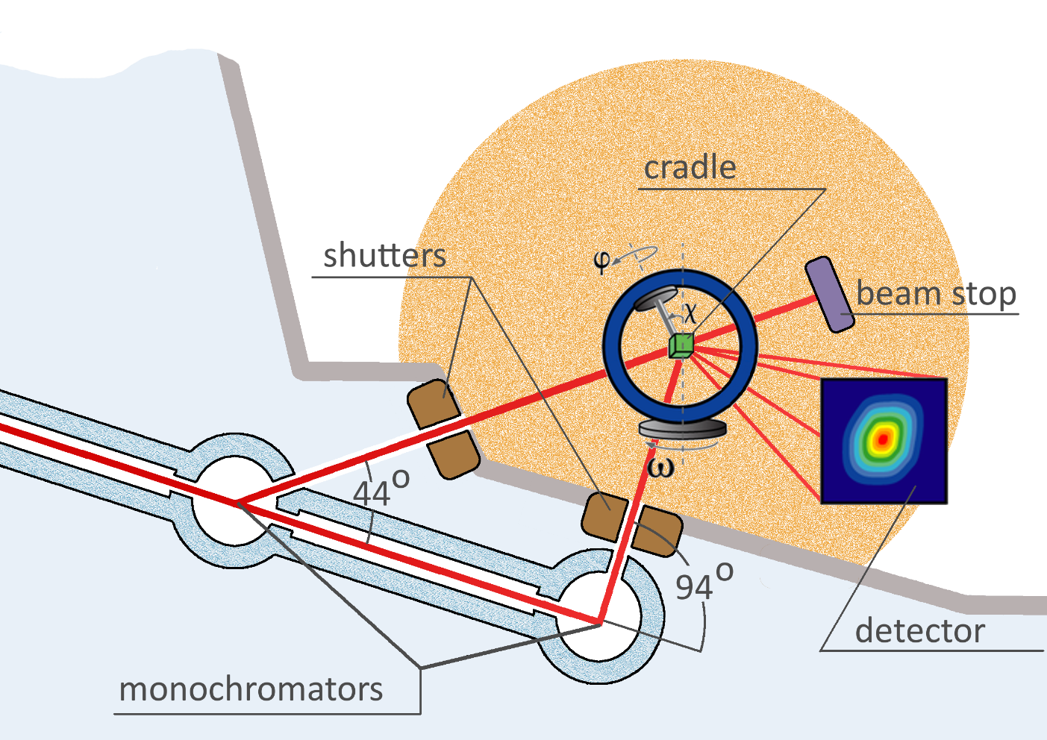
The principal scheme of the TEX diffractometer
Euler cradle with a ring diameter of ~ 400 mm;
PSD detector
the lifting the detector system at angles up to 40 degrees, “Flat-Cone“ method;
two monochromators with take-off angle is 44° and 94°.
neutron wavelength for different reflecting Ge planes.
take-off аngle | Ge(111) | Ge(311) | Ge(511) | Ge(533) | Ge(711)
44° | 2.45 Å | 1.28 Å | 0.81 Å | 0.65 Å | 0.59 Å
94° |  | 2.50 Å | 1.59 Å | 1.26 Å | 1.16 Å

Slide 6
Desired parameters
Flux on the sample | 10⁸ n/(cm²s)
Resolution (∆d/d) | 5∙10⁻⁴
Computer simulation:
optimization of neutron optical scheme of diffractometer TEX (the optimal distance between nodes, the feasibility of using a focusing monochromator and so on).
estimation of resolution and luminocity of the TEX diffractometer working in different modes
The TEX diffractometer is close to the reactor wall. These leads to increase of the background level, that should be estimated.

Slide 7
Thank you for your attention!

