Slide 1
Parameters of the new
diffractometer “ARES”
Aleksey E. Sokolov
PNPI NRC “KI”

Slide 2
Internal stresses in materials
Type I Stresses: Macro-stresses occurring over distances that involve many grains within a material.

Slide 3
Internal stresses in materials
Type II Stresses: Micro-stresses caused by differences in the microstructure of a material and occur over distances comparable to the size of the grain in the material. Can occur in single-phase materials due to the anisotropic behaviour of individual grains, or can occur in multi-phase material due to the presence of different phases.

Slide 4
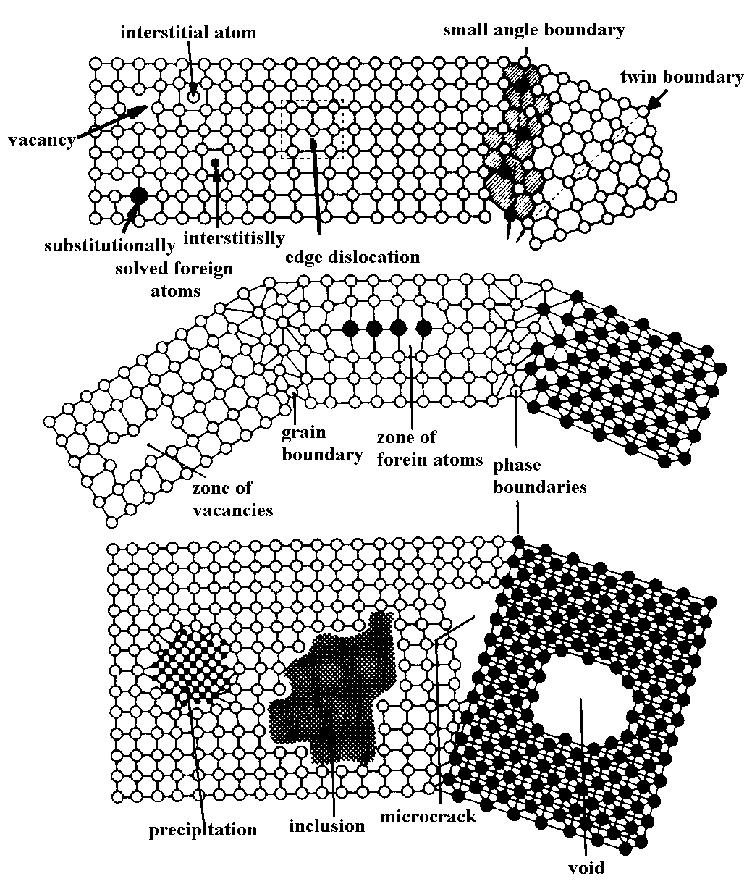
Internal stresses in materials
Type III Stresses: Exist inside a grain as a result of crystal imperfections within the grain.

Slide 5
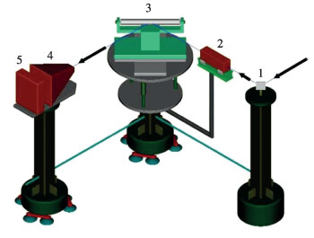
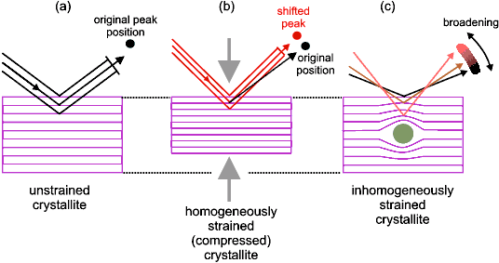
Study of internal stresses by means of the diffraction
The scheme of the experiment on the study of internal stresses in the bulk material
1 – monochromator, 2 – incident beam collimator and slits, 3 – sample, 4 – diffracted beam collimator and slits, 5 - detector
Influence of macro- and microstrains on the diffraction peak

Slide 6
Main characteristics of the stress diffractometer
The instrument requires the selection of a finite sampling volume (10-30 mm³) over which measurements are made.
The instrument evaluates the variations of lattice spacings within a sample with a step of the order of a few millimeters (determined by the dimensions of the gauge volume). Thus it requires a translation/rotation table for measurements at different locations and directions within the sampled specimen.
The diameter of the grains of polycrystalline aggregate probed should be about two orders of magnitude smaller than the dimensions of the gauge volume, which is geometrically defined by optical devices (slits, collimators) and scattering angle 2θ_{s}. The best geometrical choice corresponds to 2θ_{s}=90°, consequently the best choice is an intense Bragg peak at 2θ_{s} near 90°.
A wavelength in the range of 0.15-0.35 nm is necessary for the investigation of most commonly used crystalline materials.
Beam parameters like divergence and Δλ/λ should be adjusted such that the angular position of the sample reflections could be measured with a precision of 0.001 (which corresponds to a strain of 0.01% measured at 2θ_{s}= 90°).
Minimum fluxes at the sample position should be >5x10⁴ n/cm²/s.

Slide 7
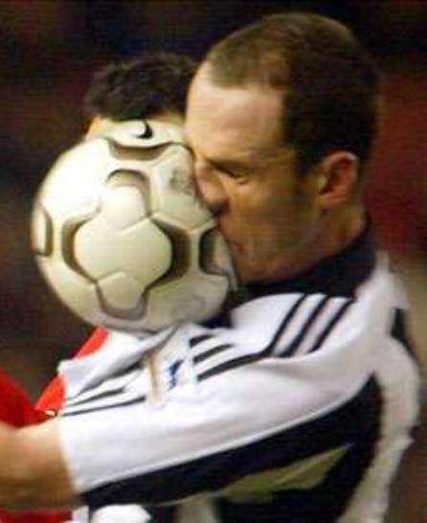
Internal stresses in materials
Hooke’s law:
σ = F/S ≈ E·ε
F
- stress
ε = Δl/l – strain
E – Young's modulus
E ≈ 45 GPa (magnesium)
E ≈ 70 GPa (aluminium)
E ≈ 200 GPa (steel)
E ≈ 400 GPa (tungsten)
Δl
Bragg law:
2d_{hkl}sinθ = λ
The shift of the peak (the lattice strain):
ε = Δd/d = -cotan(θ)Δθ
Δd_{min}/d ≈ 0.0001
(σ_{min})_{steel} ≈ 20·10¹⁰·10⁻⁴ = 20 MPa = 200 kg/сm²

Slide 8
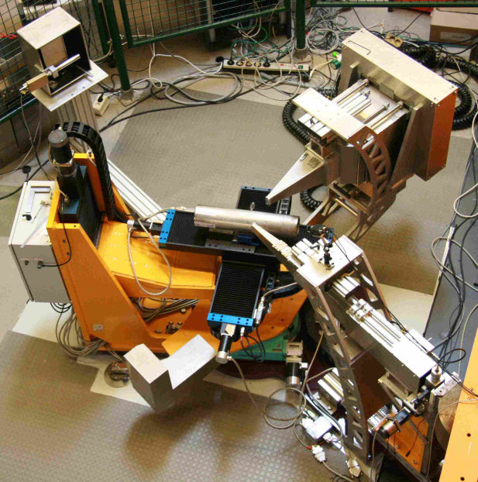
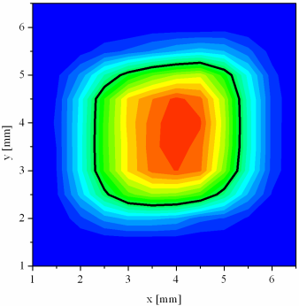
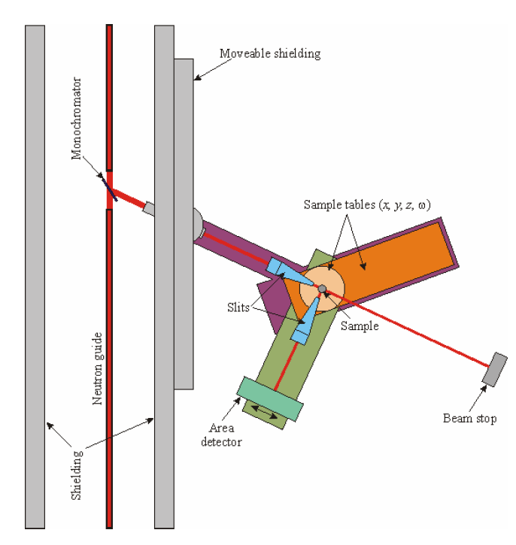
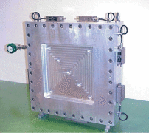
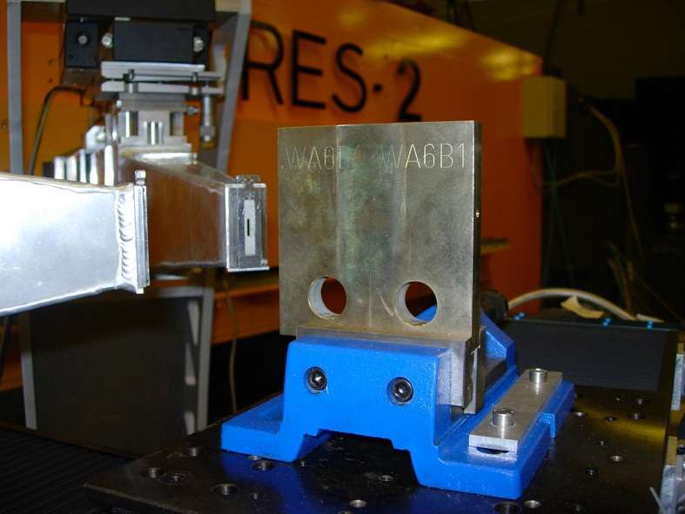
ARES -2 diffractometer (HZG --> PNPI)
g.v. 2.8x2.8x2.8 mm³
slits at L=90 mm
Instrument Details:
Location at FRG-1: beamline 7; thermal neutron guide (cross section 42x90
mm², supermirrors on top and bottom wall)
Monochromator: elastically bent perfect Si monochromator, Si (311), double focus.
Take-off angle: 57° to 120°, continuously selectable
Wavelength: λ = 0.16 - 0.23 nm
Flux at sample position: Φ ≈ 3x10⁵ n/cm²/s
Sample movements: x, y, z (range 400 mm), Ω
Detector: ³He area detector (300 mm x 300 mm)
Sample environment: Eulerian cradle (with x, y, z tables), load frame, furnace
Software: PC programs for data reduction and analysis available

Slide 9
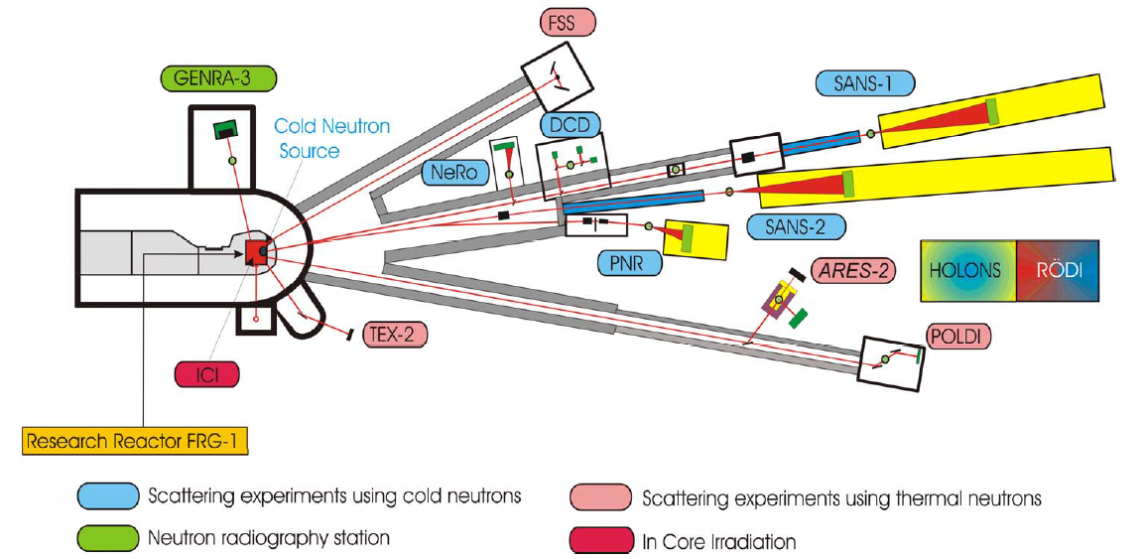
HZG

Slide 10
PNPI

Slide 11
2-D position sensitive detector
The intersection of the diffraction cone with the detector surface forms an arch that results in asymmetry of diffraction peak, especially strong in small scattering angles. This limits the height of the PSD in the powder diffractometer. At a scattering angle of 90⁰ cone degenerates into the plane, therefore at scattering angles close to 90⁰ used in the stress diffractometer asymmetry effect is small and it is possible to use detectors with the large height detectors working volume. The limiting factor is the uncertainty in the direction of the measured strain in the vertical direction.
In the detector with 300 mm height and typical distance between the sample and the detector ~ 120 cm the uncertainty in the direction of the strain measured is ±7⁰.

Slide 12
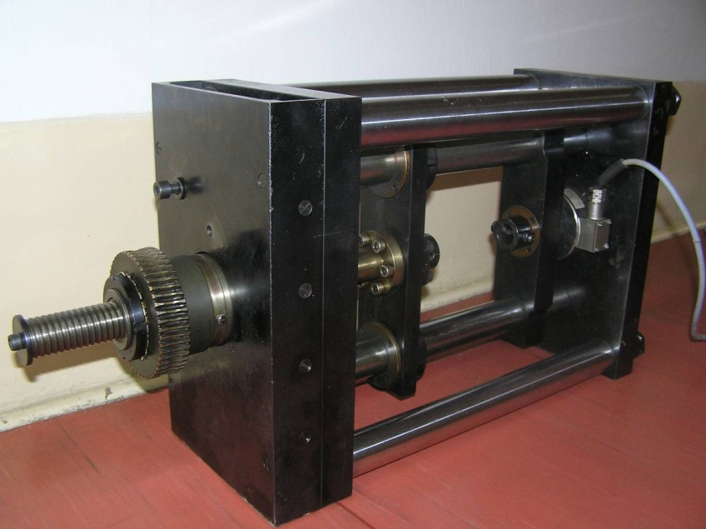
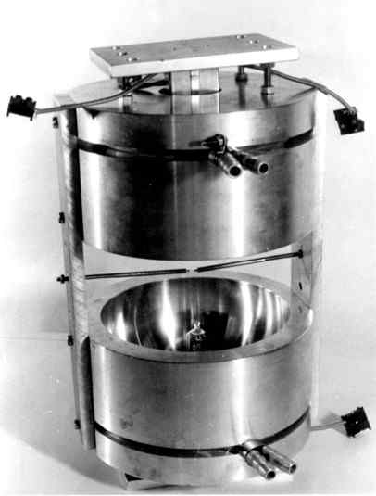
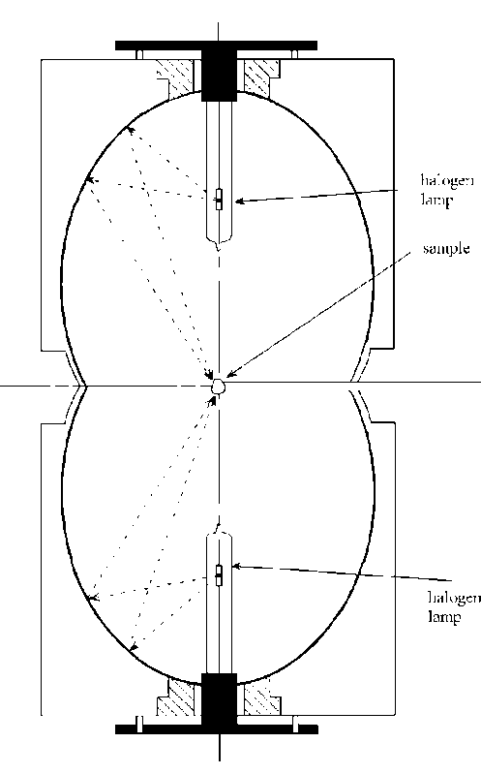
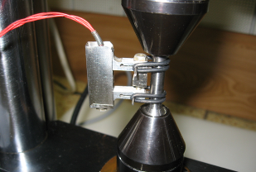
Sample equipment
Mirror furnace
power - 1 kW
max. temperature - 1000° C
Loading machine LM-20
max. load - 20 kN, max. temperature - 800 °C

Slide 13
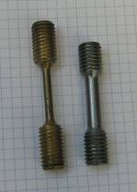
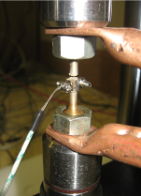
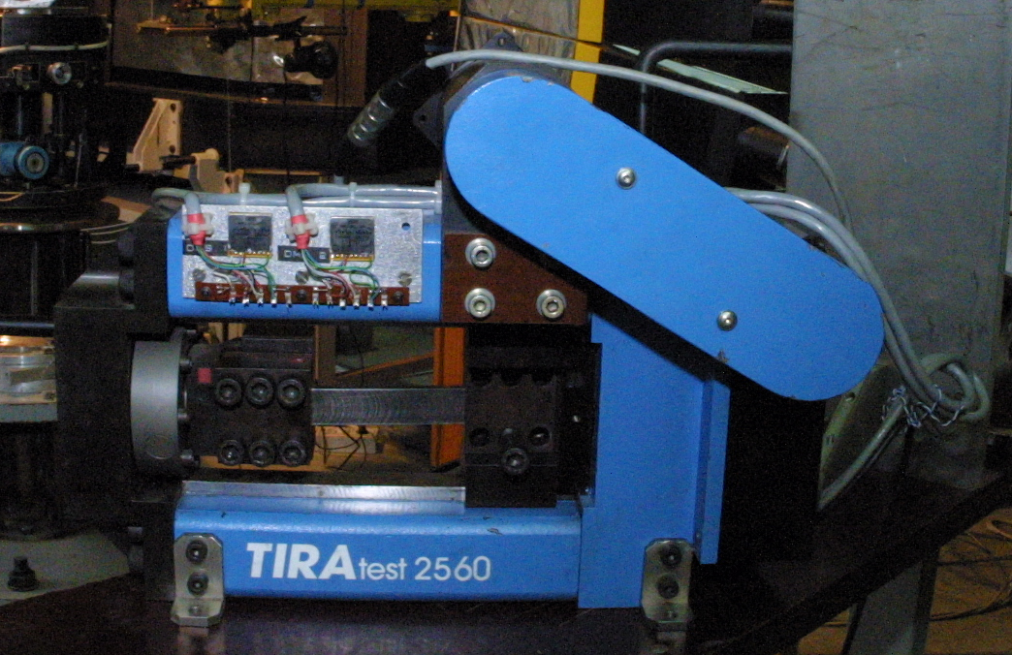
Sample equipment
Loading machine TIRAtest
max. load - 60 kN

Slide 15
And don’t ask
TOO MUCH!!!

